Slide 1
Classification
© 2025 Virginia Polytechnic Institute and State University. All rights reserved.

Slide 2
At the end of this module, you should be able to:
Define classification and the types of variables used
Identify scenarios when logistic regression would be used
Interpret the results from logistic regression
Describe when linear discriminant analysis (LDA) would be used
Implement logistic regression and LDA in Python
Evaluate model prediction quality using basic confusion matrix metrics

Slide 3
Classification

Slide 4
Introduction to Machine Learning Course Roadmap
What is the goal of the data analysis?
Predict an output |  |  |  |  |  | Reveal patterns or relationships |  | Make decisions using an autonomous agent
Supervised Learning (Output in the data set) |  |  |  |  |  | Unsupervised Learning (No output in the data set) |  | Reinforcement Learning* (Supervised & unsupervised)
Continuous or discrete output? |  |  |  |  |  | What is the subgoal? |  | Does a model exist?
Continuous |  |  | Discrete |  |  | Identify groups | Reduce dimensions | Model Based | Model Free
Simple linear regression Multiple linear regression Subset selection Ridge regression & LASSO PCR & PLS | Polynomial regression Step functions Splines Local regression General additive models | Decision tree Random forest Neural network Gradient boosting tree | Logistic regression Linear discriminant analysis Quadratic discriminant analysis | Decision tree Random forest Neural network Gradient boosting tree | Support vector machines | Hierarchical clustering K-means clustering | Principal components analysis | Given the model Learn the model | Policy Optimization Q-Learning
Logistic regression
Linear discriminant analysis
Quadratic discriminant analysis
*Advanced Topic: Bonus module if time
Notes:
In the previous modules, we covered approaches for supervised learning with a continuous response. We are now going look at techniques for supervised learning with a discrete or categorical response

Slide 5
Supervised versus unsupervised again
Some tangible measurement(s)
“The Black Box”
INPUTS
MACHINE LEARNING MODEL
OUTPUT(S)
Supervised Learning
In the context of domain knowledge
“The Black Box”
INPUTS
MACHINE LEARNING MODEL
PATTERNS,
RELATIONSHIPS, STRUCTURE
Unsupervised Learning
does it make sense?
Notes:
We want to provide you with some context of where classification methods fits into the larger scheme of machine learning. (click) Classification methods are supervised learning models. We need to have an outcome. We will focus on a binary outcome but know that we can have more than two outcomes.

Slide 6
Supervised learning method selection is based on the response type
Is my response quantitative or qualitative?
Age
Height
Income
Stock Price
Tensile Strength
Quantitative
Qualitative
Blood Type
Default on Debt (y/n)
Cancer Stage
Brand Purchased
Species
Typically use regression method
Typically use classification method
Discrete: Nominal or Ordinal
Continuous Measures
What about the predictors?
For most methods, predictors can be
either quantitative or qualitative.
Notes:
Again, (click) we are working in the classification framework.
Note that classification has a categorical outcome to predict but the predictors or the inputs to the model can be either numeric or categorical.

Slide 7
Two methods of estimation
Parametric
(Less Flexible, More Interpretable)
Non-parametric
(More Flexible, Less Interpretable)
Inference focused
Select a model which involves an assumption about the functional form of f. Train the model and estimate parameters.
Example:
f is linear in X: f(X) = β₀+β₁X₁ + β₂X₂ +…+ β_{p}X_{p}
Prediction focused
Does not make explicit assumptions about the functional form of f. Can fit wider range of possible shapes for f, but at that cost of needing a larger number of observations.
Example:
Tree-based methods
Notes:
Emphasize that in this module, we are on the parametric side of things
Future modules will focus on non-parametric methods for classification (e.g. tree-based methods)
Parametric techniques are more interpretable. Depending on the goals for your project, this might be an advantage. You may need to quantify the strength of an association as well as the magnitude and direction. Of course, you may have to sacrifice some predictive capability in order to gain the interpretability.

Slide 8
Classification

Slide 9


Does a person’s job require a hat?
Can we predict whether a person wears a hat at work if we know some other things?
Age
Wears uniform
Education
Hours worked per day
Notes:
First let’s get an intuitive idea of classification with an simple example. Let’s consider the idea of predicting whether someone is likely to wear a hat for their job based on: Age, Wears uniform, Education, Hours worked per day. While you might find this example a bit silly, it illustrates the idea of taking a variety of variables and using them to assign a label. In this the case the label is hat versus no hat.
Classification is simply the act of assigning labels to observed data.
We want to predict an observation’s label from other known attributes of the observation.

Slide 10


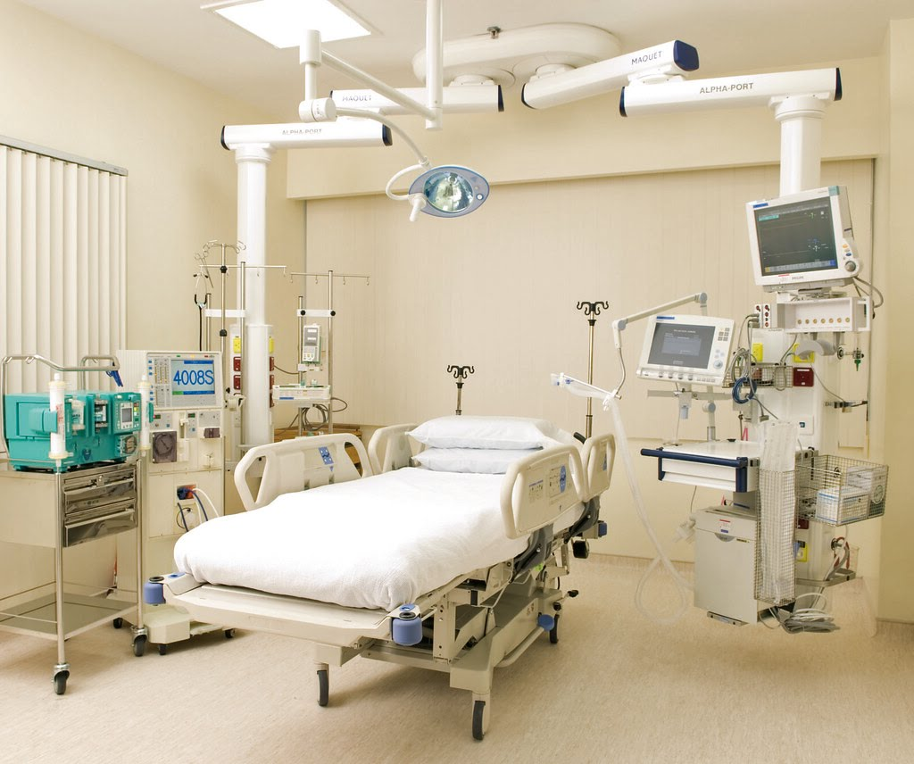

Some more serious classification example problems
Will a person default on their credit card or not?
Which category will a new credit card applicant be in: good credit, bad credit, or gray area?
Is an insurance claim fraudulent or not?
Is a patient at risk for a particular condition?
Which patients should be sent to the ICU?
Will someone pass a licensure exam?
Notes:
Some more serious classification example problems might include:
Will a person default on their credit card or not?
Which category will a new credit card applicant be in: good credit, bad credit, or gray area?
Is an insurance claim fraudulent or not?
Is a patient at risk for a particular condition?
Which patients should be sent to the ICU?
Will someone pass a licensure exam?
Note that some of these classification problems may have more than two response categories. We are going to focus on binary responses with two categories in this module but please know there are other approaches that could be used where there are more than two categories. These include ordinal logistic regression and nominal logistic regression.

Slide 11
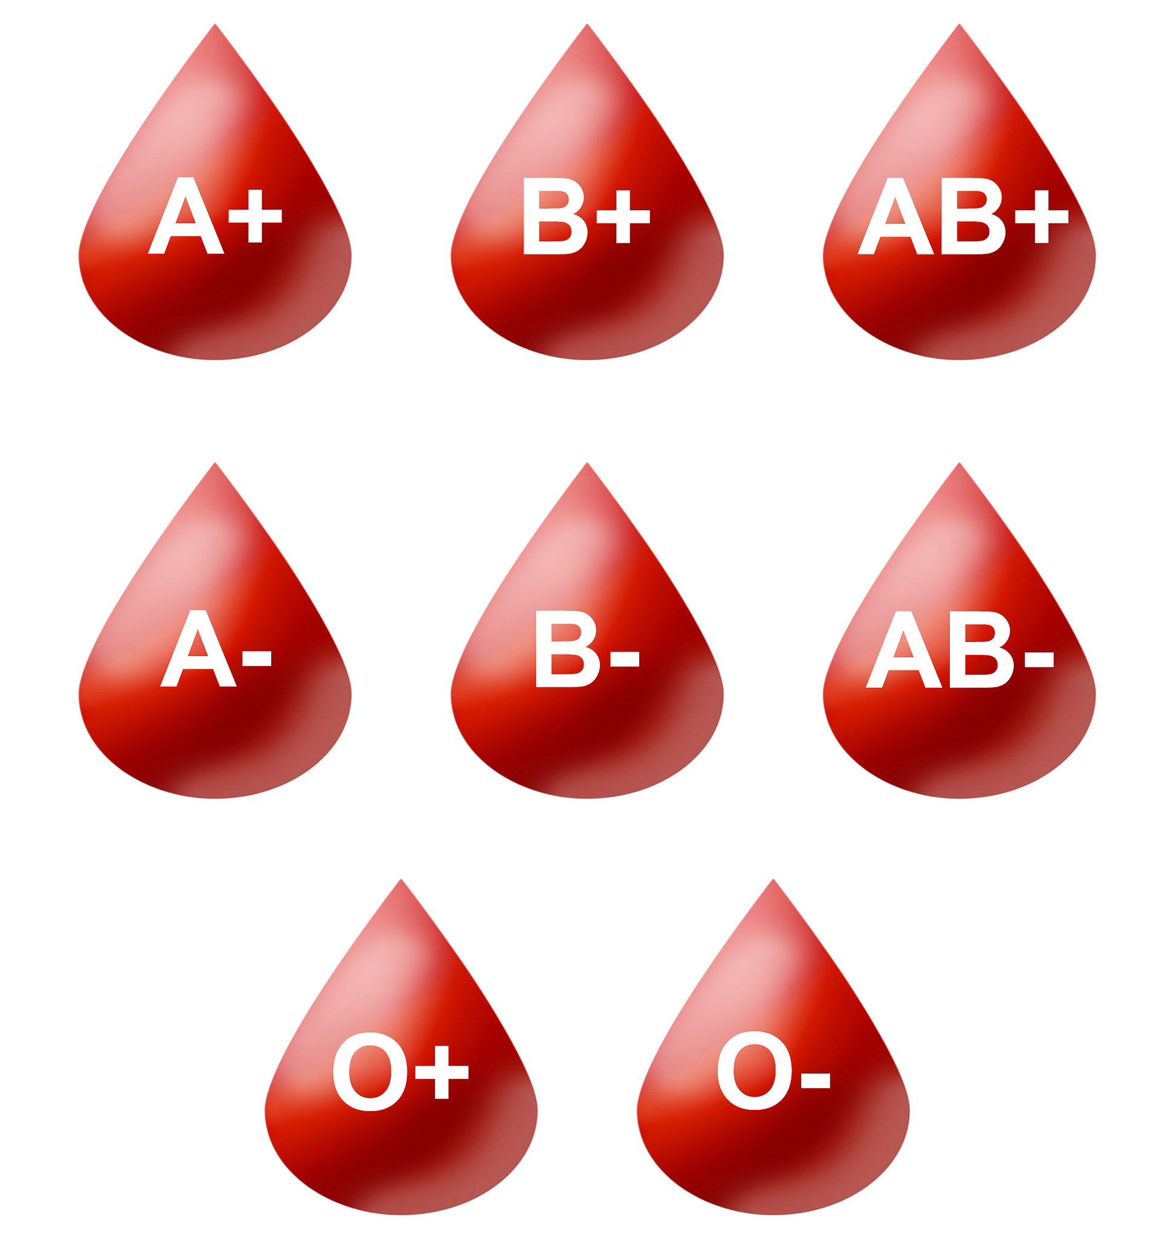

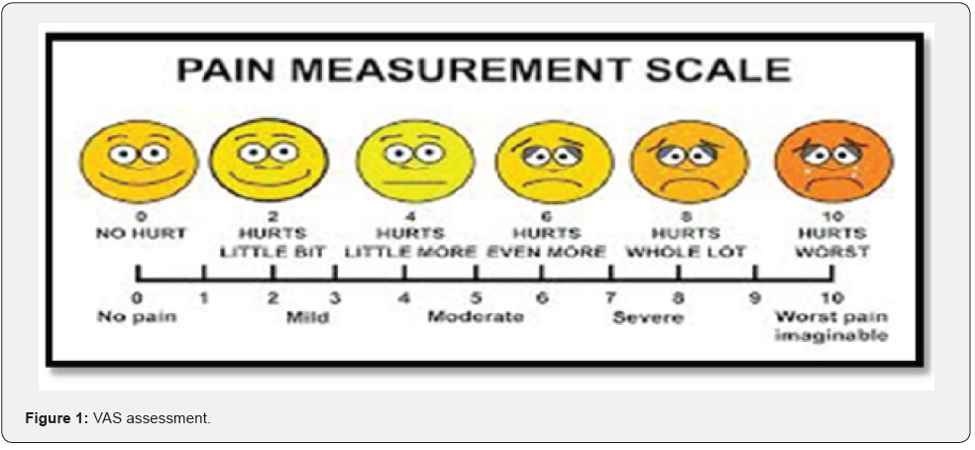

Variable types
Choosing the type of analysis/model will always to some degree depend on the type of variables in our dataset
Variable Types
Numerical
Categorical
Discrete
Continuous
Ordinal
Nominal
Variables can only take on non-fractional values, e.g. number of trips to grocery store per month
Variables can take on fractional values, e.g., height
Order matters, some outcomes are better than others
Order doesn’t matter, no outcomes are better than others
65.75 inches
6
4
Notes:
Before proceeding to the algorithms, let’s cover the different types of variables.
Recall that our data can either be numeric or categorical. Types of numeric data include discrete or count data where our variables take on an integer value >= 0 such as number of trips to the grocery store per month. Data that can take on fractional values is continuous data. Height measured in inches might be examples of this. Categorical variables include two or more groups and the group labels may be text or numerical. When the group values of a categorical variable take on an order such as low, medium, high we call them ordinal. When order does not matter, such as blood type, we call these nominal.
The type of variable can determine what algorithm we use. Sometimes we can convert the type of variable into another type based on the algorithm we choose.​

Slide 12
What do the numbers mean & how can we use them?
Numbers convey information about order and quantity; distance between any 2 values is the same; 0 is absolute; fractional values are not possible; might summarize using the mean or median.
Discrete: 0 1 2 3 4 5 6 …
Numerical
Numbers convey information about order and quantity; distance between any 2 values is the same; 0 not always absolute; fractional values are possible; might summarize using the mean or median.
Continuous: 0.0 0.1 0.2 0.3 …
Numbers convey information about order or ranking; the distance between any 2 values is not assumed the same; might summarize using the median or maybe the mean; if the number of values is limited, say <10, we might use percent at each value.
Ordinal: 1 2 3 4 5 6 …
Categorical
Nominal: 2 5 1 4 7 8 3 …
Numbers are only convenient labels for category names and do not convey quantitative information; there is no order; summarize using the number or percent in each category.
Notes:
Let’s look at the four data types in more detail

Slide 13
Classification analysis involves a categorical Y but X’s can be numerical or categorical
The types of variables we can use as predictors, Xs
The type of variable we want to predict, Y
Variable Types
Numerical
Categorical
Discrete
Continuous
Ordinal
Nominal
Variables can only take on non-fractional values, e.g. number of trips to grocery store per month
Variables can take on fractional values, e.g. height
Order matters, some outcomes are better than others
Order doesn’t matter, no outcomes are better than others
Notes:
Note that classification analysis has a categorical outcome to predict but the predictors or the inputs to the model can be either numerical or categorical. The predictors can be any type listed on this screen.

Slide 14

Why not use linear regression for classification problems?
We want to predict the medical condition of a patient based on symptoms.
1= stroke
2= drug overdose
1= drug overdose
2= stroke
3= epileptic seizure
3= epileptic seizure

Slide 15
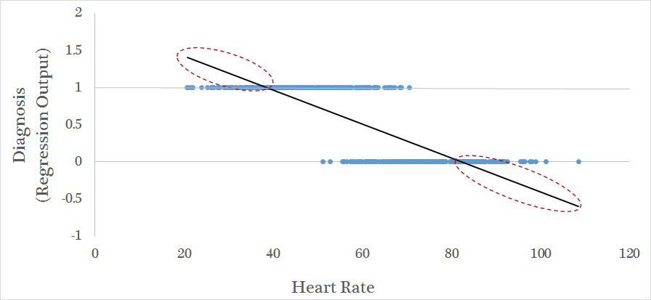
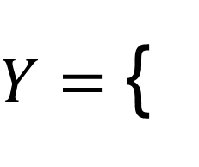
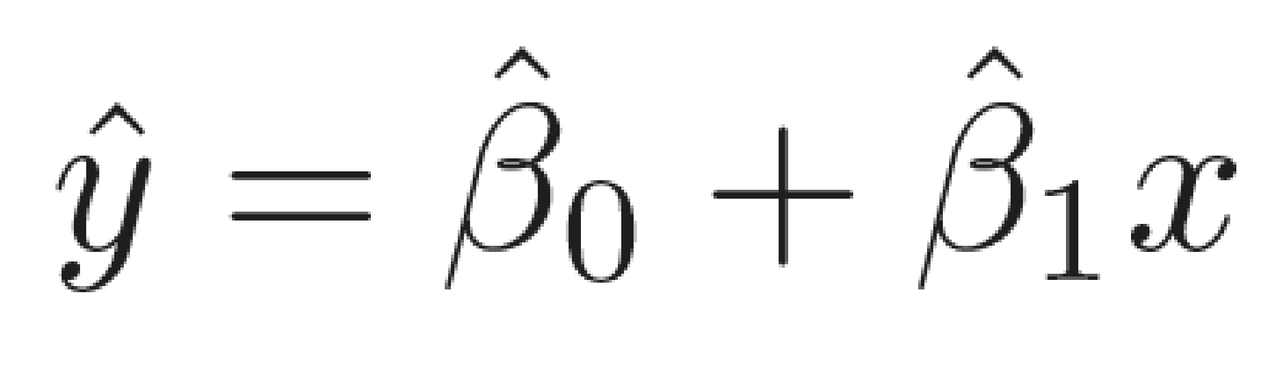
We could try linear regression with a binary outcome, but it will lead to out of range predictions
0 = no stroke
1 = stroke
We need an alternative…
Notes:
We CAN use linear regression, but we should not. Instead, we'll use types of models in this module. Note that these models don't include linear regression. ​

Slide 16
Classification

Slide 17
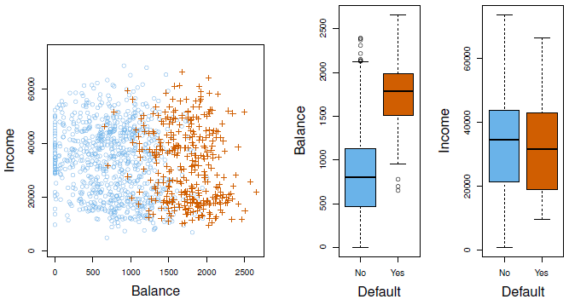
Example: Credit card payment default
Will someone default on their credit card payment?
Response: Defaulter/Non-Defaulter
Predictors:
Annual income
Monthly credit card balance
+ Defaulters
o Non-Defaulters
Notes:
Now that you have adequate context for classification, let’s look at an example. For revenue forecasting purposes, say we want to determine if a credit card holder is going to default on their payment based on their annual income and their monthly balance. Our response is whether a credit card holder is a defaulter or non-defaulter, which is a nominal variable. Our predictors are annual income and monthly credit card balance, both numerical variables.

Slide 18
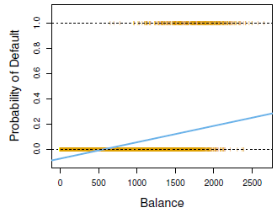
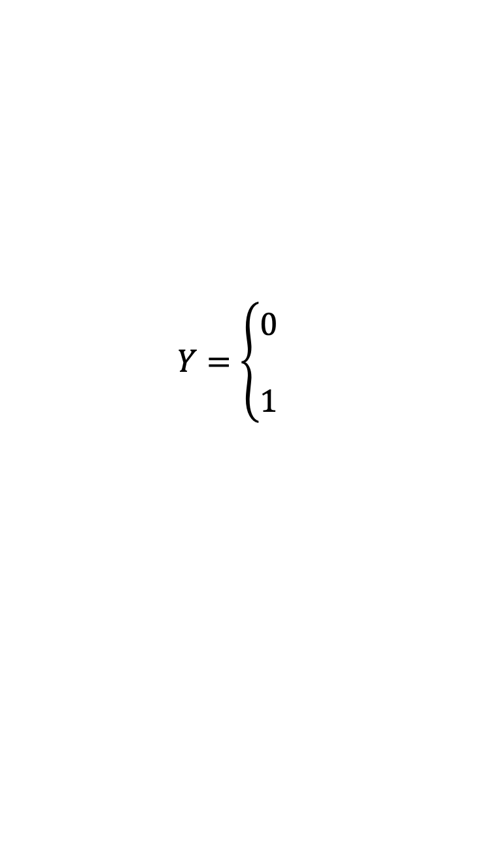

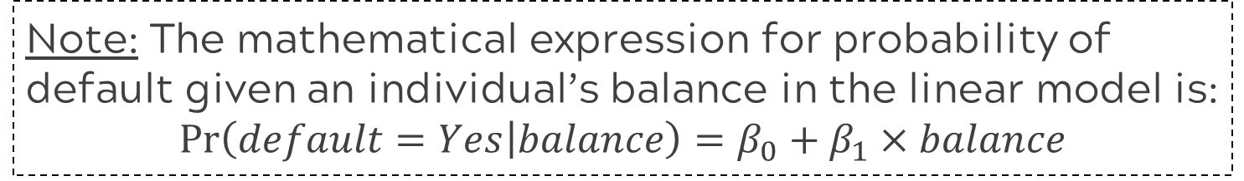
What happens with linear regression?
Did not default
if No
Defaulted
if Yes
Note: The mathematical expression for probability of default given an individual’s balance in the linear model is:
$$Pr\left(default=Yes | balance\right)=β_{0}+β_{1}×balance$$

Slide 19
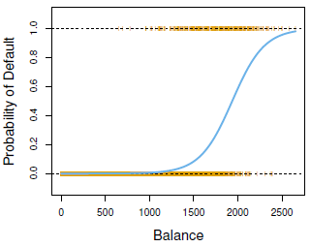

An alternative: Logistic regression
high probability
Predicted probabilities will be between 0 and 1
50% chance
low probability
Notes:
​Logistic regression is a technique that will help us predict the probability of an event. In this case, we will predict the probability of default given the individual’s balance. It is critical that you understand how the “event” in logistic regression is defined, or in other words, is default considered an event or is non-default considered an event. Confusion about event definition will lead to poor decisions based on the analysis. Behind the scenes, we assign the event, defaulting, in this case the value of 1 and non-defaulters a 0. The logistic model takes on an S-shaped curve that is constrained by 0 and 1 just like probabilities are. For our data, lower balances are associated with a lower probability of default and higher balances are associated with a higher probability of default.

Slide 20
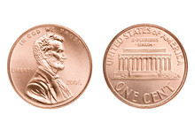
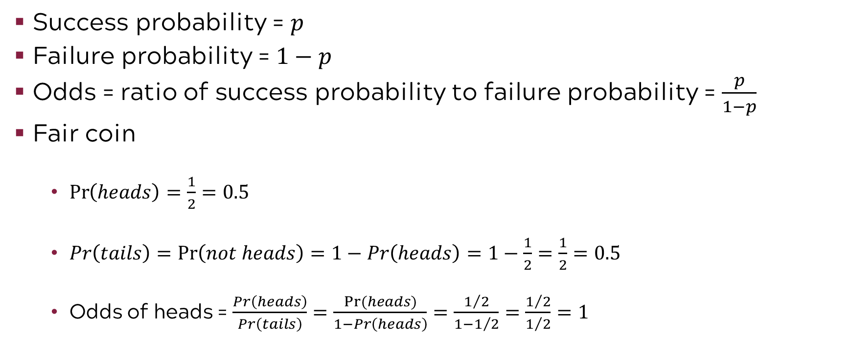
Probability and odds
Success probability = $p$
Failure probability = $1−p$
Odds = ratio of success probability to failure probability = $\frac{p}{1−p}$
Fair coin
$\operatorname{Pr}\left(heads\right)=\frac{1}{2}=0.5$
$Pr\left(tails\right)=\operatorname{Pr}\left(not heads\right)=1−Pr\left(heads\right)=1−\frac{1}{2}=\frac{1}{2}=0.5$
Odds of heads = $\frac{Pr\left(heads\right)}{Pr\left(tails\right)}=\frac{Pr⁡(heads)}{1−Pr\left(heads\right)}=\frac{1/2}{1−1/2}=\frac{1/2}{1/2}=1$
Notes:
Logit in logistic regression refers to the logit function or the log odds. Let’s digress for a moment to discuss probability, odds, and log odds
Probabilities range from 0 to 1
Odds range from 0 to +infinity
Log odds range from –infinity to +infinity

Slide 21


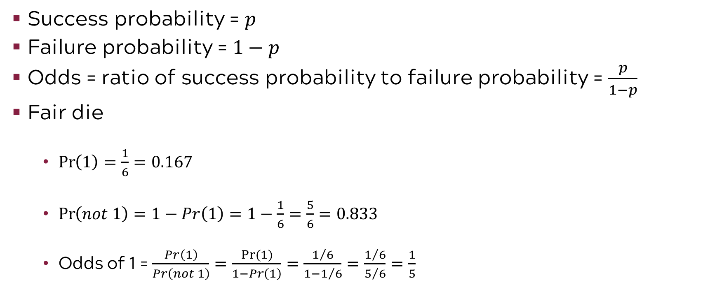
More probability and odds
Success probability = $p$
Failure probability = $1−p$
Odds = ratio of success probability to failure probability = $\frac{p}{1−p}$
Fair die
$\operatorname{Pr}\left(1\right)=\frac{1}{6}=0.167$
$\operatorname{Pr}\left(not 1\right)=1−Pr\left(1\right)=1−\frac{1}{6}=\frac{5}{6}=0.833$
Odds of 1 = $\frac{Pr\left(1\right)}{Pr\left(not 1\right)}=\frac{Pr⁡(1)}{1−Pr\left(1\right)}=\frac{1/6}{1−1/6}=\frac{1/6}{5/6}=\frac{1}{5}$
Notes:
Logit in logistic regression refers to the logit function or the log odds. Let’s digress for a moment to discuss probability, odds, and log odds
Probabilities range from 0 to 1
Odds range from 0 to +infinity
Log odds range from –infinity to +infinity

Slide 22
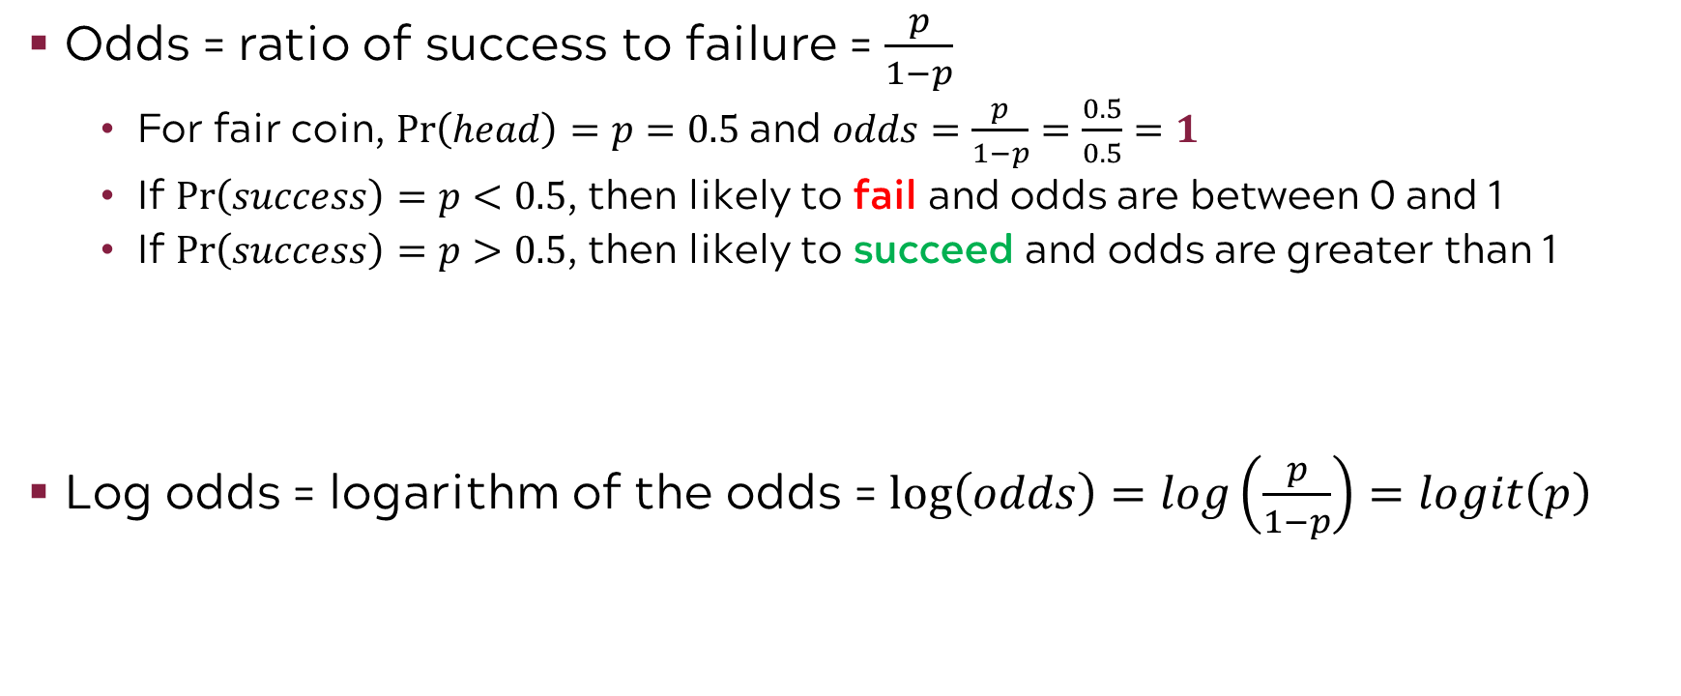
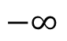

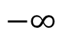

Logit = log(odds)
Odds = ratio of success to failure = $\frac{p}{1−p}$
For fair coin, $Pr\left(head\right)=p=0.5$ and $odds=\frac{p}{1−p}=\frac{0.5}{0.5}=1$
If $Pr\left(success\right)=p<0.5$, then likely to fail and odds are between 0 and 1
If $Pr\left(success\right)=p>0.5$, then likely to succeed and odds are greater than 1
Log odds = logarithm of the odds = $log\left(odds\right)=log\left(\frac{p}{1−p}\right)=logit\left(p\right)$
fail
succeed
$$−∞$$
$$∞$$
-2
-1
0
1
2
fail
succeed
$$−∞$$
$$∞$$
-2
-1
0
1
2
Notes:
Logit in logistic regression refers to the logit function or the log odds. Let’s digress for a moment to discuss probability, odds, and log odds
Probabilities range from 0 to 1
Odds range from 0 to +infinity
Log odds range from –infinity to +infinity
Taking the log adds symmetry

Slide 23
Taking the log of the odds adds symmetry
Notes:
Logit in logistic regression refers to the logit function or the log odds. Let’s digress for a moment to discuss probability, odds, and log odds
Probabilities range from 0 to 1
Odds range from 0 to +infinity
Log odds range from –infinity to +infinity
Taking the log adds symmetry

Slide 24
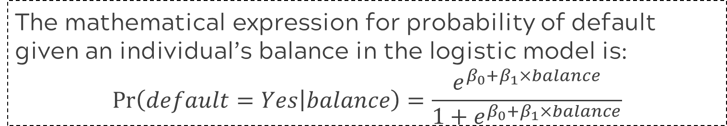
Logistic regression model
high probability
Predicted probabilities will be between 0 and 1
50% chance
low probability
The mathematical expression for probability of default given an individual’s balance in the logistic model is:
$$Pr\left(default=Yes | balance\right)=\frac{e^{β_{0}+β_{1}×balance}}{1+e^{β_{0}+β_{1}×balance}}$$
Notes:
​Now back to logistic regression…
The logistic model takes on an S-shaped curve that is constrained by 0 and 1 just like probabilities are.
If you are interested in the functional form of the model, it is shown below. While it is more complicated than a simple linear regression model, it does have the same two parameters of the slope and the intercept, denoted by beta1 and beta0 respectively.

Slide 25
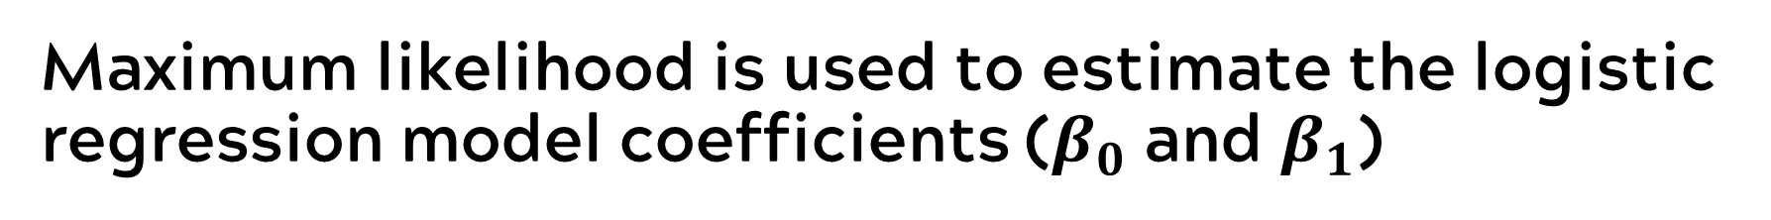
Maximum likelihood is used to estimate the logistic regression model coefficients ($β_{0}$ and $β_{1}$)
Maximum likelihood works by finding estimates for the coefficients so that the predicted probability of default for each individual corresponds as closely as possible to the individual’s actual default status.
the likelihood of the data given this line is calculated…
…as well as the likelihood of the data given this line…
…and the likelihood of the data given this line, etc.
the curve with the maximum likelihood is selected
Notes:
​The coefficients or parameters in a logistic regression model are estimated by maximum likelihood which uses an optimization method to select the slope and intercept with the most likely values based on the data. Essentially it calculates how likely it is that we got the data we have given many different curves and which ever has the highest likelihood is the line we choose.

Slide 26
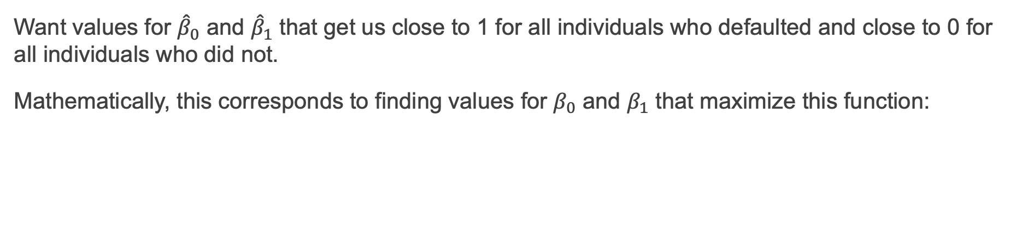
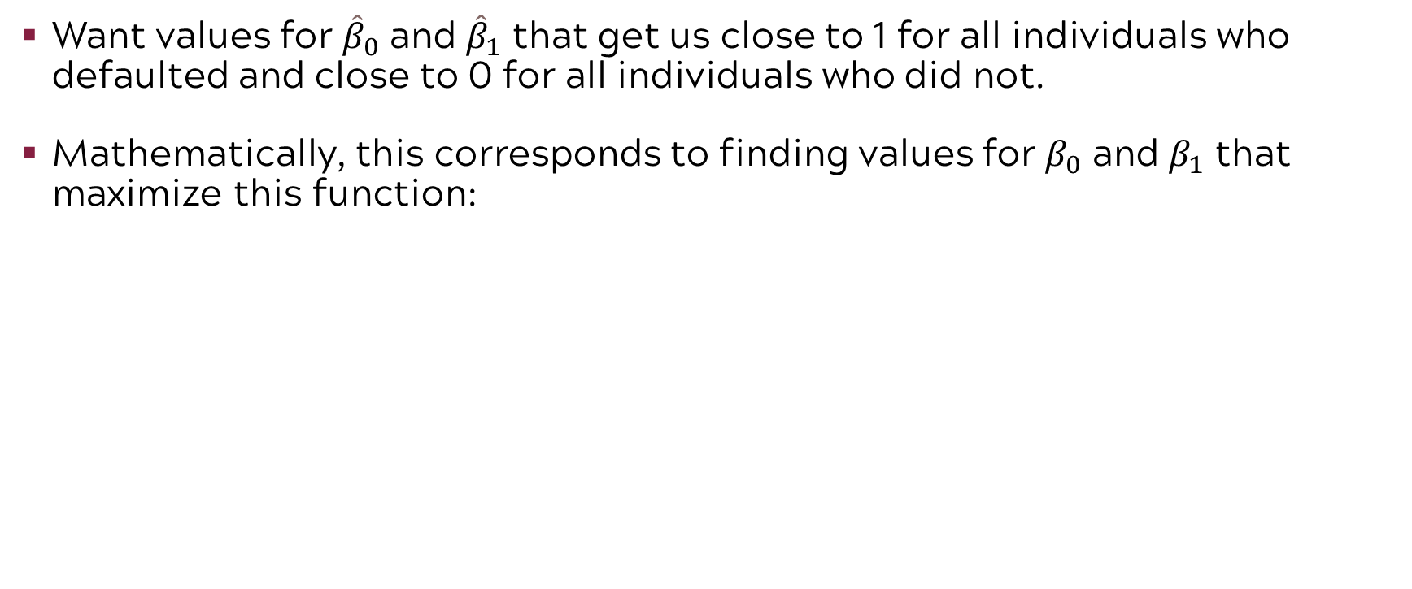
Maximum likelihood is used to estimate the logistic regression model coefficients ($β_{0}$ and $β_{1}$)
Want values for ${\hat{β}}_{0}$ and ${\hat{β}}_{1}$ that get us close to 1 for all individuals who defaulted and close to 0 for all individuals who did not.
Mathematically, this corresponds to finding values for $β_{0}$ and $β_{1}$ that maximize this function:
$$l\left(β_{0},β_{1}\right)=\prod_{y=1}{Pr\left(default=Yes|balance\right)}⋅\prod_{y=0}{(1−Pr\left(default=Yes|balance\right))}$$
Not to worry, we rely on software to do this!

Slide 27
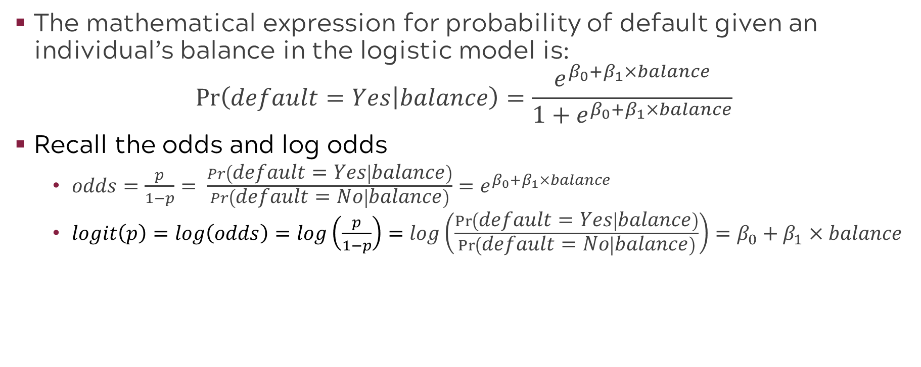
Alternative logistic model representation
The mathematical expression for probability of default given an individual’s balance in the logistic model is:
$$Pr\left(default=Yes | balance\right)=\frac{e^{β_{0}+β_{1}×balance}}{1+e^{β_{0}+β_{1}×balance}}$$
Recall the odds and log odds
$odds=\frac{p}{1−p}= \frac{Pr\left(default=Yes | balance\right)}{Pr\left(default=No | balance\right)}=e^{β_{0}+β_{1}×balance}$
$logit\left(p\right)=log\left(odds\right)=log\left(\frac{p}{1−p}\right)=log\left(\frac{Pr\left(default=Yes | balance\right)}{Pr\left(default=No | balance\right)}\right)=β_{0}+β_{1}×balance$
Notes:
These common forms help to better understand and explain the effects of estimated parameters

Slide 28
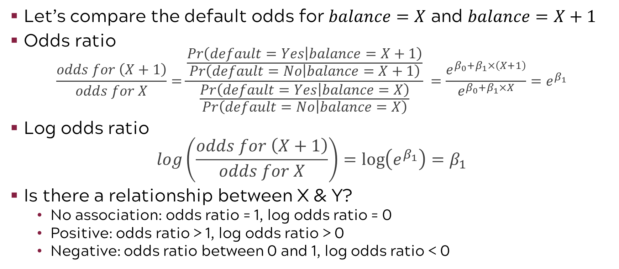
Odds ratio and log odds ratio help to understand relationships between response and predictor
Let’s compare the default odds for $balance=X$ and $balance=X+1$
Odds ratio
$$\frac{odds for \left(X+1\right)}{odds for X}=\frac{\frac{Pr\left(default=Yes | balance=X+1\right)}{Pr\left(default=No | balance=X+1\right)}}{\frac{Pr\left(default=Yes | balance=X\right)}{Pr\left(default=No | balance=X\right)}} =\frac{e^{β_{0}+β_{1}×\left(X+1\right)}}{e^{β_{0}+β_{1}×X}}=e^{β_{1}}$$
Log odds ratio
$$log\left(\frac{odds for \left(X+1\right)}{odds for X}\right)=\log\left(e^{β_{1}}\right)=β_{1}$$
Is there a relationship between X & Y?
No association: odds ratio = 1, log odds ratio = 0
Positive: odds ratio > 1, log odds ratio > 0
Negative: odds ratio between 0 and 1, log odds ratio < 0
Notes:
For a continuous predictor, we can look at the odds ratio and log(odds) ratio to understand model coefficients
”An one unit increase in balance increases the log odds ratio that someone will default by beta1”
”An one unit decrease in balance reduces the log odds ratio that someone will default by beta1”

Slide 29
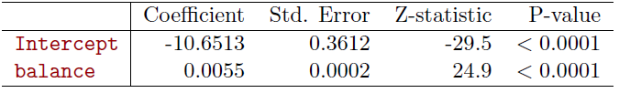
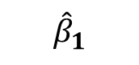
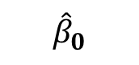
Example: Default model coefficients
Using the credit card default data, we fit a logistic regression model of default probability on balance as shown earlier. Our code returns the below output
balance is associated with
$${\hat{β}}_{0}$$
$${\hat{β}}_{1}$$
probability of default
A one-unit increase in balance (i.e., $1) is associated with an increase in the log odds of default by 0.0055 units.
Notes:
The output of a logistic regression model is similar to that of a linear regression model. We get estimated values for the intercept and the slope. And we get standard errors, test statistics and p-values. We are testing the hypotheses of “Is the slope equal to 0?” and “Is the intercept equal to 0?”

Slide 30
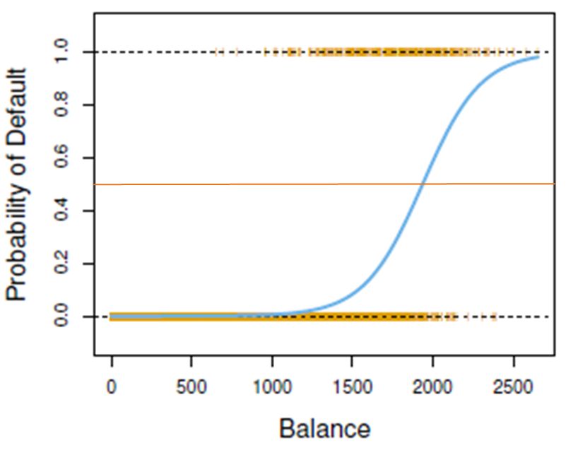
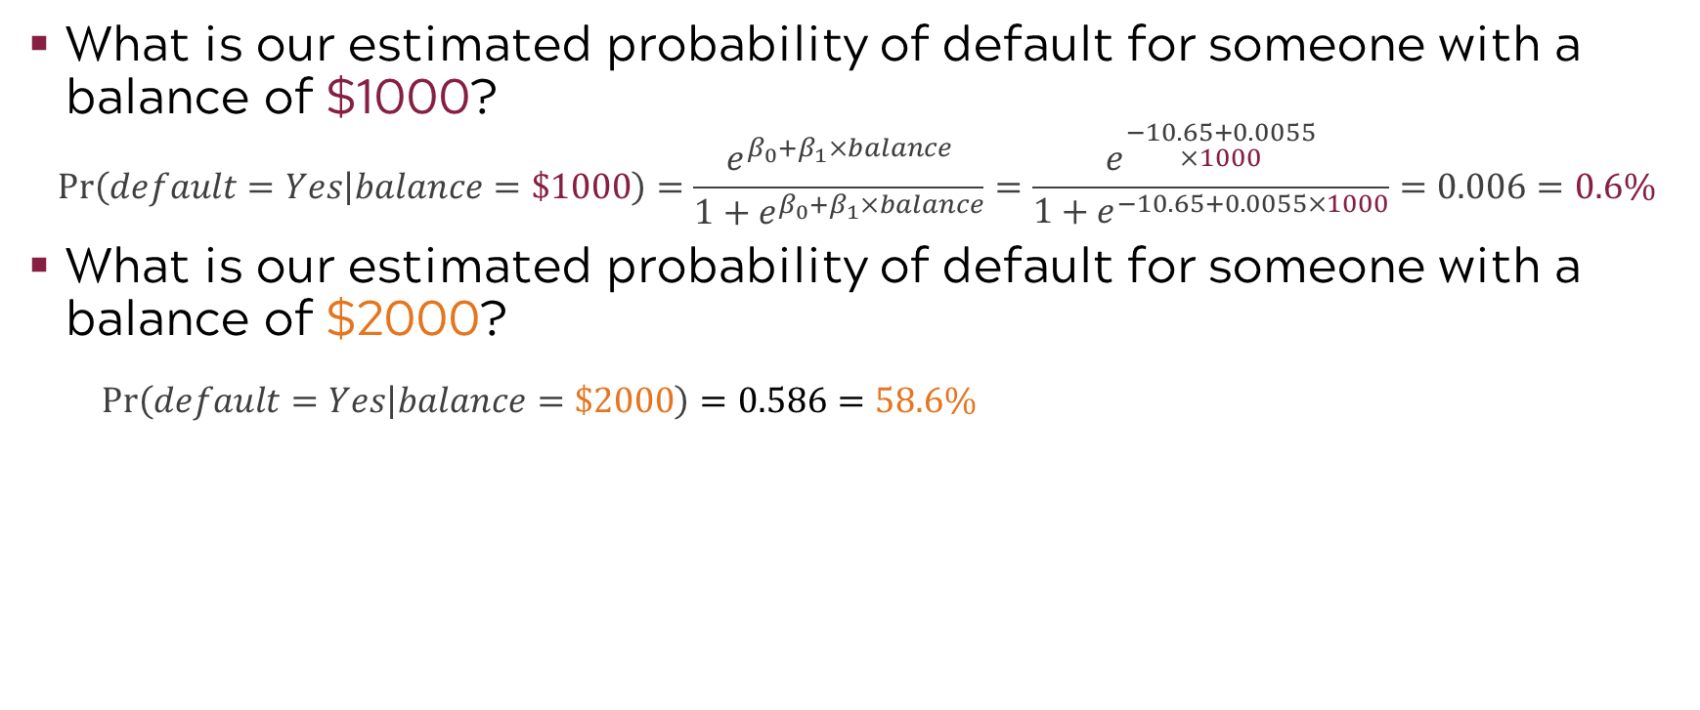
Example: Predicting default on credit card payment
What is our estimated probability of default for someone with a balance of $1000?
$$Pr\left(default=Yes | balance=\$1000\right)=\frac{e^{β_{0}+β_{1}×balance}}{1+e^{β_{0}+β_{1}×balance}}=\frac{e^{\begin{aligned}−10.65+0.0055 \\ ×1000\end{aligned}}}{1+e^{−10.65+0.0055×1000}}=0.006=0.6\%$$
What is our estimated probability of default for someone with a balance of $2000?
$$Pr\left(default=Yes | balance=\$2000\right)=0.586=58.6\%$$
Doubling the balance does not double the estimated probability; this is due to our s-shaped model.
Notes:
In this slide we will show you how we can evaluate a logistic regression formula to get a predicted probability.
Let’s evaluate the model at a balance of $1000.
(click) Making our substitutions for the slope, intercept, and x =1000 balance, we get the probability of default is 0.006 or 0.6%.
(click) Now let’s evaluate the model at a balance of $2000.
(click) Making similar substitutions for the slope, intercept, and x =2000 balance, we get the probability of default is 0.586 or 58.6%.
(click)In practice, software does this for you, but we want to make the important point that doubling the balance doesn’t double the probability due to the sigmoidal or S-shaped model.
Also, in practice we would want uncertainty estimates around these predictions which are available in the form of prediction intervals and confidence intervals.

Slide 31

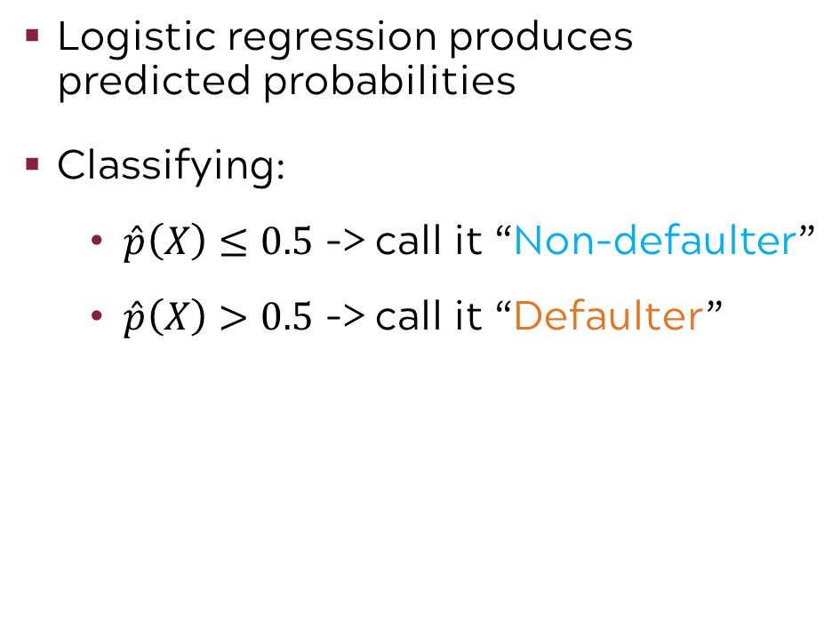
Example: Using logistic regression for classification
Logistic regression produces predicted probabilities
Classifying:
$\hat{p}\left(X\right)≤0.5$ -> call it “Non-defaulter”
$\hat{p}\left(X\right)>0.5$ -> call it “Defaulter”
Defaulters
Non-Defaulters
Notes:
Logistic regression produces the probability of an event. However, we want to classify a credit card holder into our binary categories of likely to default or not likely to default. In order to do this, we establish a threshold. Typically, that threshold is 50%. With this threshold, all credit card holders for which logistic regression produced a probability of 50% or less would be classified as a non-defaulter and all credit card holders with a probability of greater than 50% would be classified as defaulters. However, there are times you might want to modify that threshold in order to improve model accuracy or to be more conservative, as in a safety related prediction. We could just as easily set the threshold at 30% in order to determine a defaulter or a non-defaulter.
Also note that as our X (balance) value increases, the probability of default does not increase linearly. Point out probability at 500 and 1000

Slide 32
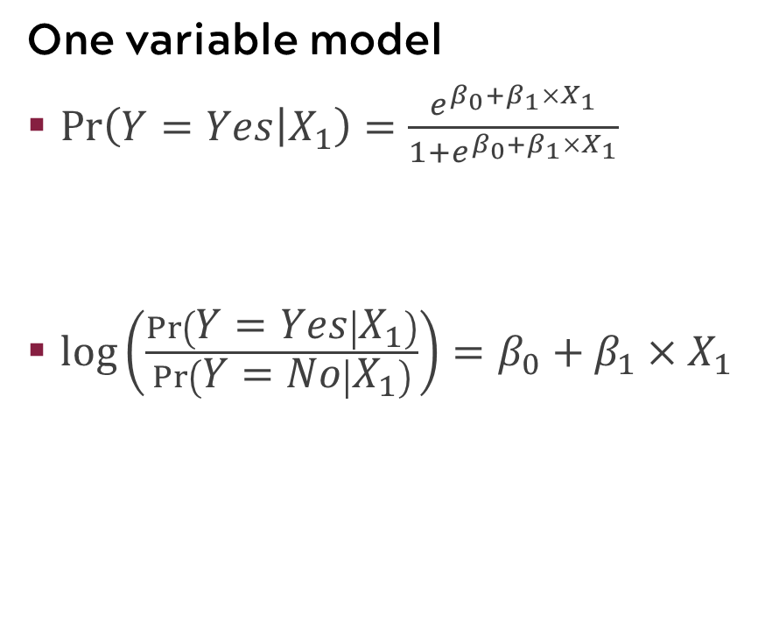
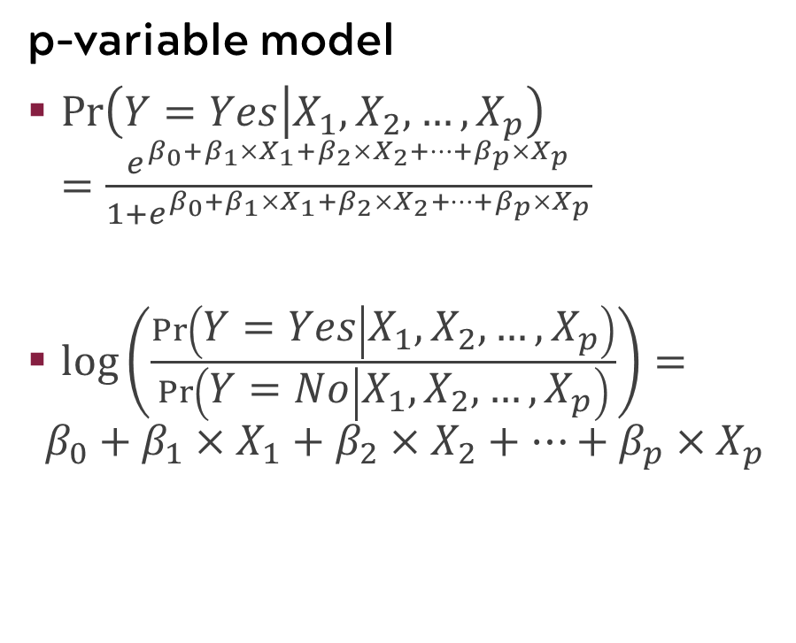
Logistic regression models can include multiple predictor variables, just like linear regression models
One variable model
$Pr\left(Y=Yes | X_{1}\right)=\frac{e^{β_{0}+β_{1}×X_{1}}}{1+e^{β_{0}+β_{1}×X_{1}}}$
$log\left(\frac{Pr\left(Y=Yes | X_{1}\right)}{Pr\left(Y=No | X_{1}\right)}\right)=$ $β_{0}+β_{1}×X_{1}$
p-variable model
$Pr\left(Y=Yes | X_{1},X_{2},…, X_{p}\right)=\frac{e^{β_{0}+{β_{1}×X_{1}+β_{2}×X_{2}+⋯+β}_{p}×X_{p}}}{1+e^{β_{0}+{β_{1}×X_{1}+β_{2}×X_{2}+⋯+β}_{p}×X_{p}}}$
$log\left(\frac{Pr\left(Y=Yes | X_{1},X_{2},…,X_{p}\right)}{Pr\left(Y=No | X_{1},X_{2},…,X_{p}\right)}\right)=$
$$β_{0}+{β_{1}×X_{1}+β_{2}×X_{2}+⋯+β}_{p}×X_{p}$$
Notes:
Recall from regression that simple linear regression can be extended to include more than one variable (more than one X), which we call multiple linear regression. Similarly, logistic regression can also be extended to include more than one variable. On the left-hand side, we can see what our model looks like with just one variable. We have one X and one slope (beta 1) for that X. On the right-hand side, we can see what the model looks like with p-variables. P can be any chosen whole number but remember the more variables added to your model, the more flexible and less interpretable it gets. We can see in the formula that we have p Xs and p slopes, one for each X.

Slide 33
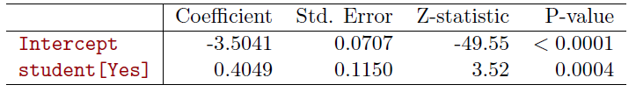
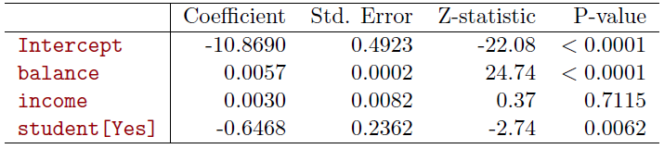
Example: Predicting default on credit card payment using multiple logistic regression
Single predictor
Multiple predictors
being a student is associated with a higher probability of default
controlling for balance and income, being a student is associated with a lower probability of default
Notes:
Parameters with P values lower than 0.05 are significant.
We can put more than one variables in a Logistic Regression model.
Note that the coefficient of Student becomes negative when other variables are added. This is sort of like conditioning.​

Slide 34
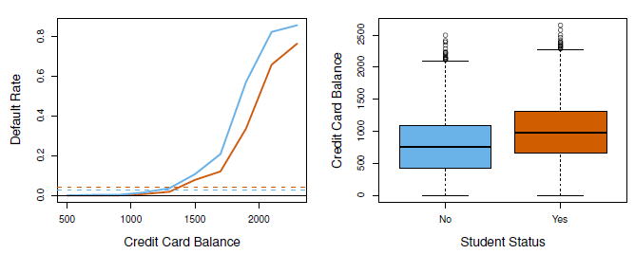
Multiple logistic regression can be used to control confounding
Non-Student Default Rate for a Given Balance
Student Default Rate for a Given Balance
Average Student Default Rate
Average Non-Student Default Rate
Notes:
The variable Student Status is confounded with Balance and Income when there's only one variable in the model.
Once we account for Balance and Income, being a Student lowers your probability of defaulting.

Slide 35
Classification

Slide 36
Discriminant analysis
Response: categorical with 2+ groups
Predictors: continuous
Linear discriminant analysis (LDA)
Linear combination of predictors (features)
A supervised dimensionality reduction technique
More stable than logistic regression for multi-class classification problems
Notes:
Classification is simply the act of assigning labels to observed data. We want to predict an observation’s label from other known attributes of the observation.
Before digging into the detailed features of Linear Discriminant Analysis, or LDA for short, let’s reinforce the key features of LDA. Essentially LDA is a linear combination of predictors (or features) being used to separate two or more classes (or categories). It is a supervised learning technique used in dimension reduction. While LDA can be used for binary prediction, where there are only two classes, it is particularly useful for predicting the category of an observation when there are more than two classes. In fact, LDA is more stable than logistic regression for multi-class classification problems.

Slide 37




Example: Admissions
Can we predict the label from some other known characteristics?
GMAT score
Undergraduate GPA
Admit
Border
Admit
Admit
No Admit
Border
Admit
No Admit
Graduate Admissions
Notes:
To further motivate LDA as a useful technique, we will use an example on admission to an executive MBA program. We have past data on students that were either admitted, were labeled as border line, or not admitted. These labels will form the classes for this example. The variables used to evaluate the students are undergraduate grade point average and the Graduate Management Admission Test, or GMAT, scores. In reality there would be many more variables that would be used to make this decision, but we want to use an example in two dimensions to we can effectively illustrate how LDA works.

Slide 38
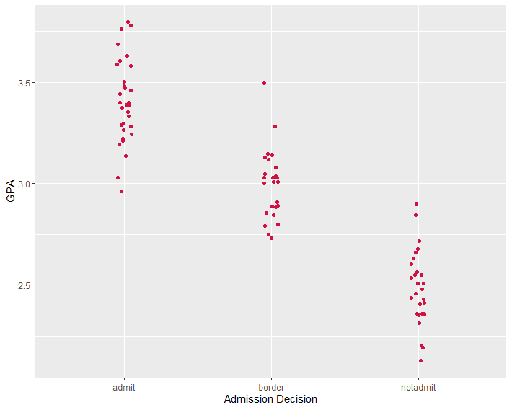
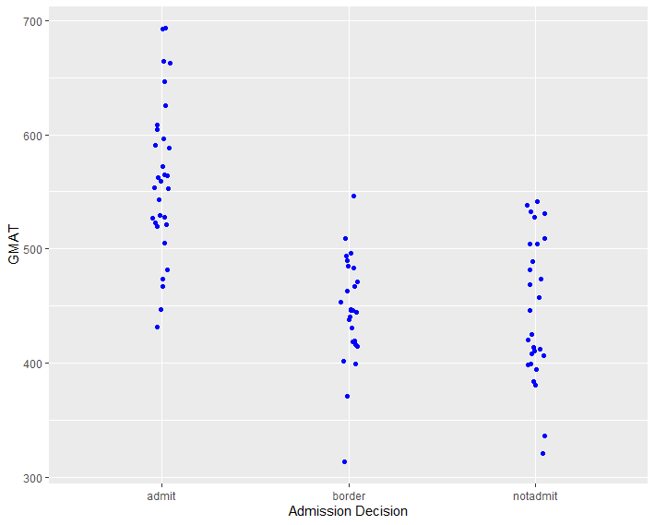
Do GPA and GMAT seem to separate the classes?
Notes:
- Let’s look at some data for our example:
- If we consider each variable separately, it looks like we can see some pretty clear separation in the groups when we look at GPA.
- GPA seems to separate admit and no admit pretty clearly, but there is overlap when it comes to the border group (maybe not surprising). We also see some separation if look at GMAT, but there is more overlap in the groups here. Maybe looking at them together would provide a different picture.

Slide 39
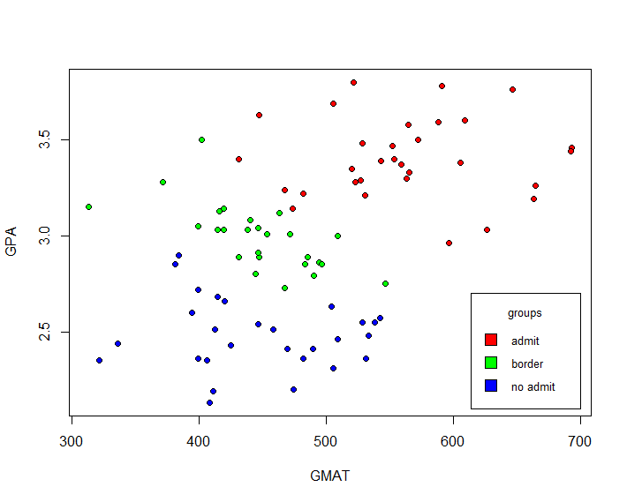
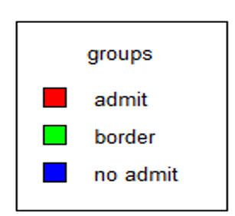
What if we consider GPA and GMAT together?
Notes:
Let’s take a look at another plot where we have our two predictors or features plotted on the vertical and horizontal axes and we color code the admissions classes as red, green, and blue respectively.
If we consider GPA and GMAT simultaneously, the separation seems to be a bit more clear.
We can actually add some lines by eye that do a pretty good job in separating the admission status classes in this simple two-dimensional case. However, this would be almost impossible in three dimensions, let alone cases where there are hundreds of variables. This is where LDA comes in.
LDA gives us a way to combine the information from the predictors (linear combinations) so that we can obtain boundaries that we can use to classify observations.
LDA uses information from both variables to create a new axis and then projects the data onto the axis in a way that maximizes separation of the categories.

Slide 40
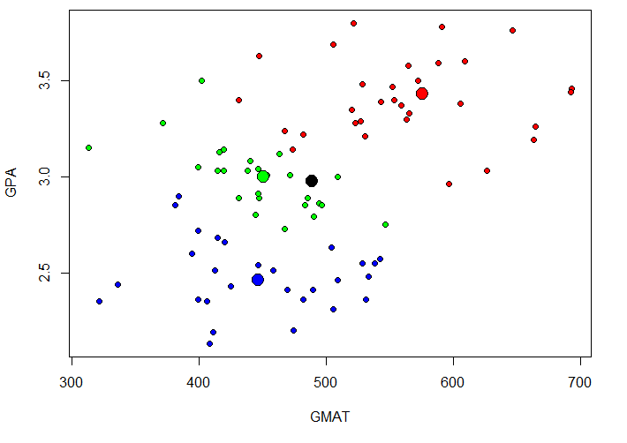
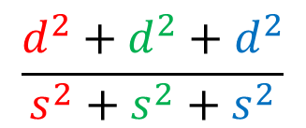
Very basic view of LDA
We want to create separation.
Come up with a function that simultaneously maximizes distances (d) between each category and the central point while minimizing the scatter of each category.
d²
d²
Maximize
d²
Minimize
Optimize
Notes:
Very basically, we can think about creating the separation in groups in terms of coming up with a function that will simultaneously maximize the distances between each category and the central point while minimizing the scatter in each category
Spread the groups and bring the points within each group closer together.

Slide 41
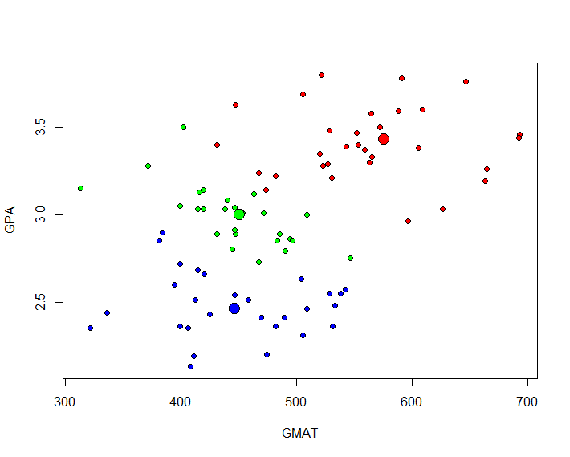
LDA creates new axes (i.e., discriminant functions)
New Axis
LDA creates two new axes to separate the data. Not a big deal with only 2 predictors, but a big deal with more.
Max number of discriminant functions: smaller(number of predictors, groups -1)
The original data points are projected onto the new axes by using the discriminant functions (linear combinations of predictors).
New Axis
Notes:
With LDA, we approach the problem by creating some new axes (discriminant functions).
In the case of only two predictors, this really isn’t a big deal; it becomes a bigger deal when we start thinking about 20 predictors.
When we implement LDA, we get new axes and then project the original data points on the new axes.
Note: the new axes on this plot are hand drawn, not actual (used only to convey the idea).

Slide 42
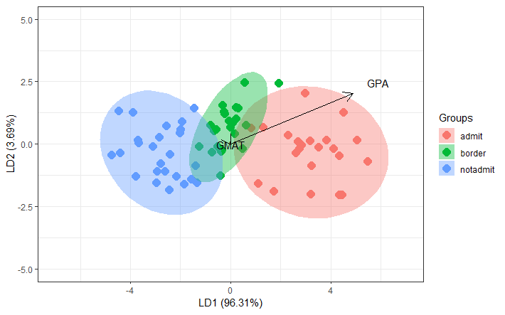
Plot in linear discriminant space
Discriminant Functions
LD1 =-19.016 +(4.907*GPA) + (0.009*GMAT)
LD2 = 1.347 + (2.036*GPA) + (-0.015*GMAT)
Notes:
Here are the data mapped onto the new linear discriminant space. Note that LD1 represents 96.3% of the variation and LD2 represents 3.7% of the variation. The discriminant functions which map our original variables into the new space are also shown. Like many other dimension reduction techniques, each new variable in the transformed space is a function of all the predictions entered into the analysis.
We end up with 2 discriminant functions (2 predictors, 3 groups-1 = 2).
Note that the magnitude of the coefficients for GPA are larger than GMAT. This indicates that GPA has a stronger influence.

Slide 43
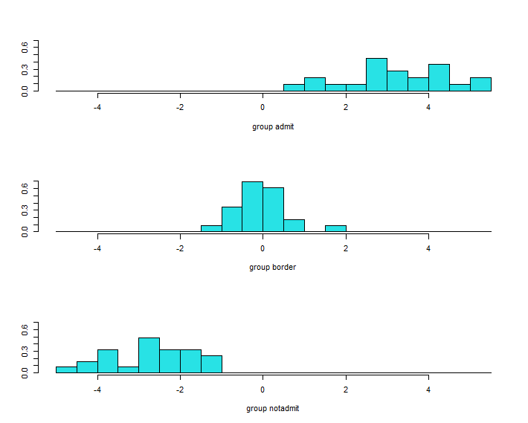
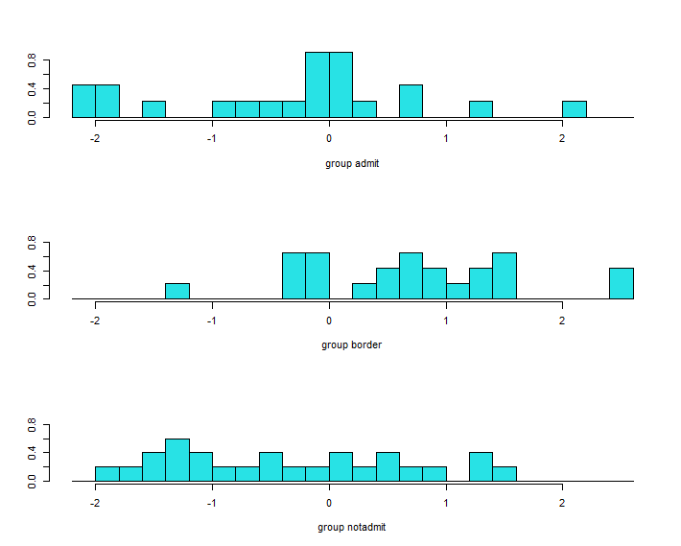
Distribution of LD variables by group
LD1 distributions
LD2 distributions
Notes:
On this slide, we see the distributions of the linear discriminant variables across the groups.
This is a frequency distribution plot of each persons score on LD1 and LD2 paneled by group
On the left we have LD1 and on the right we have LD2.
The top left is LD1 distribution for the admit group. Notice that those admitted score high on LD1
Notice how LD1, which accounted for most of the variability at 96.3%, also shows the most separation in the distributions between classes, compared to LD2 which only accounted for 3.7% of the variability.

Slide 44
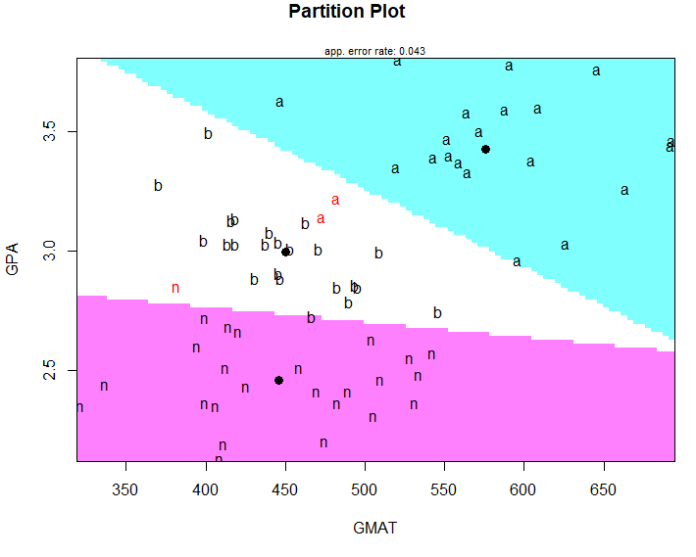

LDA predictions
Predicted probability for each class
 | Admit | Border | Not admit
1 | 0.5463 | 0.4502 | 0.0035
2 | 0.0511 | 0.9473 | 0.0016
3 | 0.2009 | 0.7987 | 0.0004
6 | 1.0000 | 0.0000 | 0.0000
7 | 0.9278 | 0.0720 | 0.0001
Actual Class
GPA GMAT Decision
1 2.96 596 admit
2 3.14 473 admit
3 3.22 482 admit
6 3.46 693 admit
7 3.03 626 admit
Class Boundaries
Notes:
A few slides ago, we talked about finding some boundaries to separate the groups.
Both the graphical output of LDA, including partition plots which show class boundaries versus the variables, and the predicted class probabilities, are useful in interpreting LDA. In the case where a smaller number of variables are primarily useful in discriminating among the classes, a series of pairwise plots, like we saw in our example, can help understand the relationships.
Since LDA gives us predicted probabilities for belonging to each class, we use these to determine predicted class. The category with the highest probability is the one chosen as the predicted class.
Thus, for the first observation in our chart on the slide, LDA produced a predicted probability for each class and the class with the highest probability was “admit”. So LDA would predict that student should be admitted to the program. (this is correct based on actual).
The next two observations would be predicted to be in the border class, but they were actually admits.
The last observations are predicted to be admits (and are).

Slide 45
LDA summary so far
Predict group membership from a set of predictors
Need to find the dimensions or dimensions along which groups differ
Find classification functions to predict group membership
Want to find linear combinations of original predictor variables that provide the best possible separation between the groups

Slide 46
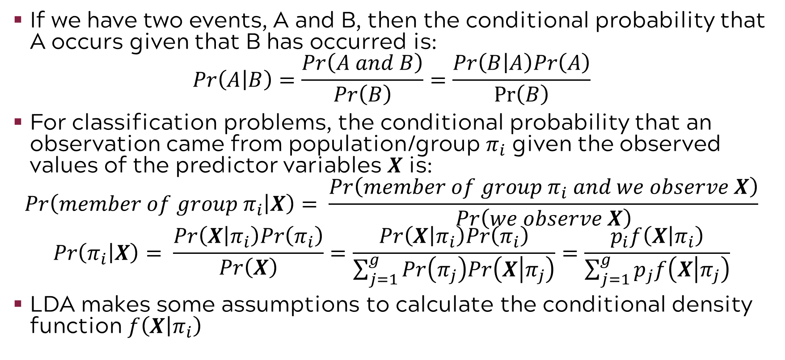
Bayes’ rule for the classification problem
If we have two events, A and B, then the conditional probability that A occurs given that B has occurred is:
$$Pr\left(A | B\right)=\frac{Pr\left(A and B\right)}{Pr\left(B\right)}=\frac{Pr\left(B | A\right)Pr\left(A\right)}{Pr⁡\left(B\right)}$$
For classification problems, the conditional probability that an observation came from population/group $π_{i}$ given the observed values of the predictor variables $X$ is:
$$Pr\left(member of group π_{i} | X\right)= \frac{Pr\left(member of group π_{i} and we observe X\right)}{Pr\left(we observe X\right)}$$
$$Pr\left(π_{i} | X\right)= \frac{Pr\left(X | π_{i}\right)Pr\left(π_{i}\right)}{Pr\left(X\right)}=\frac{Pr\left(X | π_{i}\right)Pr\left(π_{i}\right)}{\sum_{j=1}^{g}{Pr\left(π_{j}\right)Pr\left(X | π_{j}\right)}}=\frac{p_{i}f\left(X | π_{i}\right)}{\sum_{j=1}^{g}{p_{j}f\left(X | π_{j}\right)}}$$
LDA makes some assumptions to calculate the conditional density function $f\left(X | π_{i}\right)$
Notes:
Classify an observation to the population for which the value of P(π_{i}|x) is greatest
If you’d like to learn more, refer to the book
In short, we need to make assumptions and estimates to attempt to find the truth. LDA does this. But when we make assumptions, bias is always introduced.

Slide 47
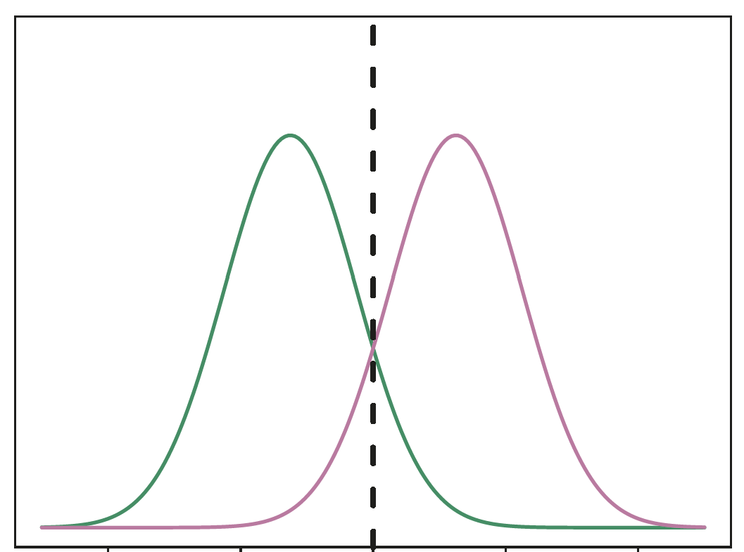
Simplifying the assumptions: Two groups and one predictor
Data is Gaussian, predictor variable is shaped like a bell curve (normal distribution).
Variance is the same across groups, values of the predictor vary around the mean by the same amount on average.
LDA algorithm uses Bayes’ theorem to try to find the best line that acts as separator between the two distributions.
Probability of observing the values of predictor for group 1
Probability of observing the values of predictor for group 2

Slide 48
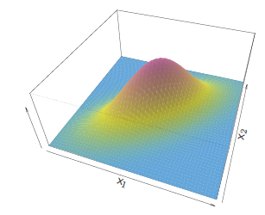
Expanding LDA to 2 or more predictors
Need to think a little differently about the assumptions (not too much)
Assume all predictors follow normal distributions and therefore any combination of predictors follows a multivariate normal distribution​
Instead of just common variances, we have to think in terms of common variances and covariances (correlations among predictors) across groups

Slide 49
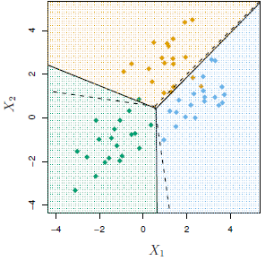
Does LDA do a good job?
An example with 3 classes and 2 predictor variables
LDA boundaries
Bayes boundaries
The dots represent our data (multivariate normal with common covariance). The colors of the dots represent the true class.
Notes:
Bayes here is the gold standard, as mentioned in the intro.
From text: In practice, even if we are quite certain of our assumption that X is drawn from a Gaussian distribution within each class, to apply Bayes classifier we still have to estimate the parameters…LDA approximates the Bayes classifier by plugging in estimates
LDA is trying to estimate those boundaries, and it’s doing a pretty good job of it.

Slide 50
QDA (Quadratic Discriminant Analysis) vs. LDA
If classes seem to have different variability (different variances/ covariances), we can use QDA instead of LDA.
We need to estimate variability for all classes, instead of assuming it is the same for all groups.
Estimating more things allows for more flexibility in the model (we have more things we can change) but increases variability of estimates from sample to sample (Bias-Variance trade-off)
Which is better? It depends.

Slide 51
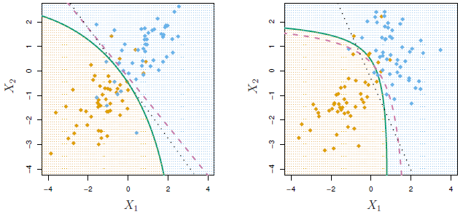

QDA vs. LDA example with 2 classes and 2 predictors
True Divider
LDA boundary
QDA boundary
Variability same for both classes. True boundary linear. LDA does a good job. QDA adds variability but no bias improvement.
Variability different for each class. True boundary is nonlinear. LDA is biased. QDA adds variability but offers bias improvement.

Slide 52
Which to use: QDA or LDA?
Don’t use discriminant analysis
NO
Does the distribution of the data have a bell shape (i.e., Normal distribution)?
Use LDA
Do the different classes show a difference in how they are spread out?
NO
YES
Use QDA
YES

Slide 53

Exercise: The stock market
Data set with 1089 observations and 9 variables:
Year: The year that the observation was recorded
Lag1: Percentage return for previous week
Lag2: Percentage return for 2 weeks previous
Lag3: Percentage return for 3 weeks previous
Lag4: Percentage return for 4 weeks previous
Lag5: Percentage return for 5 weeks previous
Volume: Volume of shares traded (average number of daily shares traded in billions)
Today: Percentage return for this week
Direction (Response): A factor with levels Down and Up indicating whether the market had a positive or negative return on a given week

Slide 54
ML paradigm to evaluate model performance
Test Error: average error that results from using a machine learning method to predict the response on data that was not used in training the method
Models are built to do well on the data they’ve been fed. We want to ensure they also do well on data they haven’t encountered.
Whole Sample
Randomly
divide
Training set
Fit
Model
Prediction
Validation set
Tune
Test
Test Error
Test set
Notes:
Before we jump into the exercise, recall the ML paradigm to evaluate model performance with test error
A common way to evaluate its performance in this paradigm is through test error. The model is used to make predictions on the test set, which the model has not yet “seen”, and from these predictions we can get test error. Test error is the average error that results from using a machine learning method to predict the response on data that was not used in training the method. Remember, the model was only built using the training and validation sets, thus it was built to do well on that data. We want to ensure the model will also do well on new data, which is why a test set is used.
Recall for the purposes of this course, we will limit ourselves to training and test (exclude validation)

Slide 55
Code road map
1) Import Modules + Packages
2) Visualize Data
3) Build Training + Test Datasets
4) For each model:
Fit model with training data
Generate predicted labels
Evaluate performance
Notes:
Also recall our code rode map

Slide 56

Review: K nearest neighbors (KNN)
When we have real data, we often use kNN to classify which gives us results close to the Bayes classifier.
Method to classify X:
Select the 3 points nearest to X. These 3 points represent the neighborhood.
What fraction of those points are blue? (Probability of being blue) What fraction is gold? (Probability of being gold)
Classify X as blue if the majority of the points in the neighborhood are blue. Classify X as gold if the majority of the points are gold.

Slide 57
1) We will begin by importing the modules and packages we need
R Code
imports the needed packages
library(ISLR)
library(MASS)
library(class)
data(Weekly)
imports the dataset into the workspace
Python Code
imports the relevant libraries
import numpy as np
import pandas as pd
import statsmodels.api as sm
from sklearn.discriminant_analysis import LinearDiscriminantAnalysis as LDA
from sklearn.discriminant_analysis import QuadraticDiscriminantAnalysis as QDA
from sklearn.model_selection import train_test_split
from sklearn.neighbors import KNeighborsClassifier as KNN
from ISLP import load_data
from ISLP.models import (ModelSpec as MS, summarize)
from ISLP import confusion_table
weekly = load_data('Weekly')
imports the relevant models
imports the dataset into the workspace

Slide 58


2) Next we perform some visual analysis
R Code
pairs(Weekly[,-9], pch=".")
for(i in 2:8){
boxplot(Weekly[,i]~Weekly$Direction,ylab=colnames(Weekly)[i])
}
scatterplots
boxplots
Notes:
ADD PAIRS PLOT

Slide 59


2) Next we perform some visual analysis
Python Code
pd.plotting.scatter_matrix(weekly, figsize=(15, 15), marker='o’,
hist_kwds={'bins': 20}, s=6, alpha=.8,
range_padding=0.2);
for i in range(1, 7):
colName = weekly.columns[i]
weekly.boxplot(column=colName, by="Direction")
scatterplots
boxplots

Slide 60

The scatterplot matrix can help visualize correlations
The only correlation not near zero is between Year and Volume
The correlation between today’s return (Today) and percentage returns for the previous 5 days (Lag1-5) are nearly zero

Slide 61
3) Next we will split the data into two portions. One part will be used to construct the model (train). The second part will be used to evaluate model performance (test).
R Code
- establishes the percentage of the total dataset that will be used for training (85% in this example)
n0 <- round(nrow(Weekly)*.85)
n1 <- nrow(Weekly) - n0
trnum <- sample(1:nrow(Weekly), size=n0)
train <- Weekly[trnum,]
test <- Weekly[-trnum,]
- creates indices for training data
- first line uses indices to build training data from original dataset. Second line takes the remainder as testing data
Notes:
Before we begin our model construction, we will split the data into two portions. One part will be used to construct the model (train). The second part will be used to evaluate model performance (test).-
REMINDER: We are not doing any model tuning (validation step) in this course

Slide 62
3) Next we will split the data into two portions. One part will be used to construct the model (train). The second part will be used to evaluate model performance (test).
Python Code
- Randomly splits Weekly data into a training set (85%) and test set (15%)
weekly_train, weekly_test = train_test_split(weekly, random_state=47,
test_size=0.15)
allvars = weekly.columns.drop(['Today', 'Direction', 'Year'])
design = MS(allvars)
X_train = design.fit_transform(weekly_train)
X_test = design.fit_transform(weekly_test)
y_train = weekly_train.Direction == 'Up'
y_test = weekly_test.Direction == 'Up’
L_train = weekly_train.Direction
L_test = weekly_test.Direction
- sets up X with just predictors of interest and y with response values
- sets up categorical y labels for prediction
Notes:
Before we begin our model construction, we will split the data into two portions. One part will be used to construct the model (train). The second part will be used to evaluate model performance (test).-
REMINDER: We are not doing any model tuning (validation step) in this course

Slide 63
4.1) Now we fit a logistic regression model with Direction as the response and the five lag variables plus Volume as predictors
R Code
trainglm1 <- glm(Direction ~ Lag1 + Lag2 + Lag3 + Lag4 + Lag5 +
Volume, data=train, family=binomial())
summary(trainglm1)
fits the model
displays the output
Python Code
sets up the model
glm_train = sm.GLM(y_train, X_train,
family = sm.families.Binomial())
results = glm_train.fit()
results.summary()
fits the model
displays the output

Slide 64
4.2) Next we fit a LDA model
R Code
fits the model
trainlda1 <- lda(Direction~ Lag1 + Lag2 + Lag3 + Lag4 + Lag5 + Volume, data=train)
Python Code
establishes the model
lda = LDA(store_covariance=True)
X_train = X_train.drop(columns=['intercept'])
lda.fit(X_train, L_train)
drops intercept from X_train
fits the model

Slide 65
4.3) Next we fit a QDA model
R Code
fits the model
trainqda1 <- qda(Direction~Lag1 + Lag2 + Lag3 + Lag4 + Lag5 + Volume, data=train)
Python Code
establishes the model
qda = QDA(store_covariance=True)
qda.fit(X_train, L_train)
fits the model
(Don’t need to drop intercept from X_train since we did it in the last step)

Slide 66
4.4) Finally we fit a KNN model
R Code
extracts predictors from training/test data
trainK <- train[, c("Lag1", "Lag2", "Lag3", "Lag4", "Lag5",
"Volume")]
testK <- test[,c("Lag1","Lag2","Lag3","Lag4","Lag5","Volume")]
knnPred1 <- knn(trainK, testK, train$Direction, k=1)
fits the model, with k=1
Python Code
converts X_train to an array
X_train_arr = np.asarray(X_train)
knn1 = KNN(n_neighbors=1)
knn1.fit(X_train_arr, L_train)
sets up a kNN model with k=1
fits the model

Slide 67
Classification
Notes:
Now we will look at evaluating the model predicting quality with the confusion matrix

Slide 68

Evaluating prediction with the confusion matrix
In a continuous setting, we look at predicted versus actual plots!
In a classification setting, we look at the confusion matrix.
Predicted close to actual!
Actual or True
Predicted=Actual Line
Category | A | B | C | D
A
B
C
D
Prediction is not as close to actual
Predicted
Predicted perfectly!
Predicted
Actual
Notes:
In both simple and multiple linear regression, we use a predicted versus actual plot to assess how well our model is predicting. (click) If our model predicted perfectly, all the points would lie on the 45 degree line where predicted=actual. (click) We know we have real world variability so it is actually pretty rare that points line up along the predicted versus actual line. (click) Instead you will see them on either side of the line.
We have an analogous way of evaluating classification models. (click) We do this by creating a table where we tally the counts of observations from an actual category that have a particular predicted category. This is called the confusion matrix. If our model predicted perfectly we would see all of the counts along the diagonal of the confusion matrix where the predicted category = actual category. (click) These cells are denoted by the green check marks. Of course, we will not be able to achieve a perfect prediction record in actuality. (click) We will be off the diagonal of the confusion matrix where we see the red Xs. Our modeling algorithms will work to help us minimize the counts in the boxes with the red Xs and maximize the counts in green check mark cells subject to the variability in our data. We can look at confusion matrices for multiple models and select the one that best fits our needs. Note that is not always the one with the highest accuracy but more on that later!
To evaluate the performance of each of our models we will build a confusion matrix.
A confusion matrix is a square with the horizontal categories indicating the model’s prediction and vertical categories indicating the true values. A perfect model would have all elements in the confusion matrix residing in the diagonal, this indicates that prediction and actual values are perfectly concurring
In practice, we will always see some deviations
We will insert counts an percentages of matches in our confusion matrix.
We will also define some important metrics around the confusion matrix.
There are four categories in this plot but we will look at our binary stock market example in detail in the next few slides.

Slide 69

Confusion matrix for predicting default on credit card payment
True Default Status
(from actual data)
Category | No | Yes | Total
No | 9,644 | 252 | 9,896
Yes | 23 | 81 | 104
Total | 9,667 | 333 | 10,000
Predicted Default Status (from model)
Overall error rate = (23 + 252) / 10000 = 2.75%
Notes:
A particular model (Model 1) makes predictions on a dataset of 10,000 individuals, with the following results.
This is a confusion matrix resulting from that classification model. Since the confusion matrix can be rather confusing, it is best to go through it step-by-step. First, the predicted payment plan default status is the row label for this table. The true or actual payment plan default status is in the columns. Note that we include the row totals and the column totals as well as the overall total
Overall error rate (or misclassification rate) is 2.75%

Slide 70
Comparison of overall error rates
Model 1
Model 2
True Default Status (from actual data)
True Default Status (from actual data)
Category | No | Yes | Total
No | 9,644 | 252 | 9,896
Yes | 23 | 81 | 104
Total | 9,667 | 333 | 10,000
Category | No | Yes | Total
No | 9,432 | 138 | 9,570
Yes | 235 | 195 | 430
Total | 9,667 | 333 | 10,000
Predicted Default Status (from model)
Predicted Default Status (from model)
Overall error rate = (23+252)/10000 = 2.75%
Overall error rate = (235+138)/10000 = 3.73%
Does a lower overall error rate mean a better model?
Notes:
Model 2 results in a higher overall error (or misclassification) rate. Does that mean it’s a better model?
We will look at other metrics to consider.

Slide 71
Confusion matrix for predicting default on credit card payment
True Default Status
(from actual data)
True Negatives:
Model said they wouldn’t default and they didn’t.
Category | No | Yes | Total
No | 9,644 | 252 | 9,896
Yes | 23 | 81 | 104
Total | 9,667 | 333 | 10,000
False Negatives:
Model said they wouldn’t default and they did.
Predicted Default Status (from model)
True Positives:
Model said they would default and they did.
False Positives:
Model said they would default and they didn’t.
Notes:
Build the slides through the animation and talk about each type of error.
The upper left cell defined by Predicted=No and Actual=No represents our true negatives. (click) In this case the model correctly indicated these folks would pay us back and they did. These 9,644 people were non-defaulters which and the model correctly predicted their status.
The next cell we will examine is also on the diagonal. These are the true positives. (click) In this case our model predicted default=Yes and these people did actually default on their payment plan. The 81 people in this cell are true positives. Although, ironically their positive status is actually a blight on their credit record and a possible criminal offense.
Next we move to the upper right cell in the body of the table where the predicted status = No or non-default and the true or actual status is Yes. Our model predicted incorrectly. The model said they would not default and they did. (click) This is a false negative status because the model falsely predicted Default=No.
Finally, let’s look at the false positives. (click) The false positives occur when we predict a default and the tax payer did not default in our actual data set.
We will talk about how we will use quantities calculated from the confusion matrix in a few minutes. But first we want to discuss some practical aspects of evaluating the confusion matrix.
You can also tee up the next slide by asking which error is worse? A False negative where we approve a person that is unlikely to pay us back or where we fail to approve a person that would pay us back.
The costs for a false negative include the loss on the loan, the time and resources to seize assets, legal fees, etc.
The costs for a false positive includes missed loan initiation fees, missed interest income, etc.

Slide 72
All errors are not created equal
In model 2, we performed worse on predicting non-defaulters.
In model 1, we performed worse on predicting defaulters.
Which error costs more?
Model 1
Model 2
True Default Status (from actual data)
True Default Status (from actual data)
Category | No | Yes | Total
No | 9,644 | 252 | 9,896
Yes | 23 | 81 | 104
Total | 9,667 | 333 | 10,000
Category | No | Yes | Total
No | 9,432 | 138 | 9,570
Yes | 235 | 195 | 430
Total | 9,667 | 333 | 10,000
Predicted Default Status (from model)
Predicted Default Status (from model)
Overall error rate = (23+252)/10000 = 2.75%
Overall error rate = (235+138)/10000 = 3.73%
Lower overall rate isn’t always the best model!
Notes:
It is worth noting that not all errors are created equal. Consider the confusion matrices from the earlier default data.
Look at model 1. The overall model error rate is 2.75%
Now look at model 2. The overall model error rate is 3.73%
Should we always go for the model with the lowest error rate or the highest accuracy?
No, why?
We can’t check our common sense at the door. We have to interpret our model in the contest of our research or business problem.
Let’s look at the types of errors for model 1. (Go over slide annotations.)
No look at the types of errors for model 2. (Go over slide annotations.)
Which costs more?
A lender might prefer model 2 to model 1 despite its overall poorer performance, if the negative impact of missing a defaulter is significantly worse than incorrectly denying a loan to a non-defaulter
This illustrates the importance of human judgment
In real life, we can associate costs with various misclassifications. That is beyond the scope of this course.

Slide 73
All errors are not created equal
False positive rate = 23 / (23 + 9644) = 0.24%
False positive rate = 235 / (235 + 9432) = 2.43%
True negative rate = 9644 / (9644+252) = 97.45%
True negative rate = 9432 / (138 + 9432) = 98.56%
Model 1
Model 2
True Default Status (from actual data)
True Default Status (from actual data)
Category | No | Yes | Total
No | 9,644 | 252 | 9,896
Yes | 23 | 81 | 104
Total | 9,667 | 333 | 10,000
Category | No | Yes | Total
No | 9,432 | 138 | 9,570
Yes | 235 | 195 | 430
Total | 9,667 | 333 | 10,000
Predicted Default Status (from model)
Predicted Default Status (from model)
Overall error rate = (23+252)/10000 = 2.75%
Overall error rate = (235+138)/10000 = 3.73%
Lower overall rate isn’t always the best model!
Notes:
It is worth noting that not all errors are created equal. Consider the confusion matrices from the earlier default data.
Look at model 1. The overall model error rate is 2.75%
Now look at model 2. The overall model error rate is 3.73%
Should we always go for the model with the lowest error rate or the highest accuracy?
No, why?
We can’t check our common sense at the door. We have to interpret our model in the contest of our research or business problem.
Let’s look at the types of errors for model 1. (Go over slide annotations.)
No look at the types of errors for model 2. (Go over slide annotations.)
Which costs more?
A lender might prefer model 2 to model 1 despite its overall poorer performance, if the negative impact of missing a defaulter is significantly worse than incorrectly denying a loan to a non-defaulter
This illustrates the importance of human judgment
In real life, we can associate costs with various misclassifications. That is beyond the scope of this course.

Slide 74

General key to the confusion matrix
 | True Event Status (from actual data)
Predicted Event (from model) | Category | - | + | Total
 | - | True Neg (TN) | False Neg (FN) | N*
 | + | False Pos (FP) | True Pos (TP) | P*
 | Total | N | P | Grand Total
Sometimes the rows and/or columns of the confusion matrix are switched around. If you are interpreting the output from a confusion matrix or comparing this presentation to an alternate source, make sure you line up the Predicted and the True or Actual as well as the positives and negatives.
Notes:
Before evaluating our models we will establish some important definitions for binary outcome models that will be useful for any model evaluations moving forward
Consider a binary outcome situation where your observations are either positive (non-Null) or negative (Null) (think testing positive vs. negative for some disease)
Here we have a general key to the confusion matrix. This is a good cheat sheet.
The idea of false positives, false negatives and true positives, true negatives can be processed pretty easily with a bit of thought. However, we also go one step further and calculate some rates of these totals that can be meaningful.

Slide 75
Some common classification evaluation metrics
Evaluation Relative to | Metric | Formula | AKA (Also Known As)
True Status (Data) | False Pos Rate | FP/N | Type I Error, 1 - Specificity
 | True Pos Rate | TP/P | 1 – Type II Error, Power, Sensitivity, Recall
 | False Neg Rate | FN/P | Type II Error, 1 – Sensitivity
 | True Neg Rate | TN/N | 1-Type I Error, Specificity
Prediction (Model) | Pos Pred Value | TP/P* | Precision, 1 – False Discovery Rate
 | Neg Pred Value | TN/N* | 1 – False Omission Rate
 | False Discovery Rate | FP/P* | 1 – Positive Predictive Value
 | False Omission Rate | FN/N* | 1 – Negative Predictive Value
Notes:
The idea of false positives, false negatives and true positives, true negatives can be processed pretty easily with a bit of thought. However, we also go one step further and calculate some rates of these totals that can be meaningful. Here we have common metrics for classification predictions. This is a good cheat sheet.
False Positive Rate is the false positives count divided by the total number of negatives in the actual data set. It is also known as Type 1 Error or Specificity. You want this to be low. A high false positive rate would be a bad thing.
True Positive Rate is the true positive count divided by the total number of positives in actual data set. It is known as Power or Sensitivity. You want the True Positive Rate to be high. This would mean you are classifying positives accurately.
The positive predicted value is the number of true positives divided by the total number of positive predictions from the model. It is also known as precision or 1-False Discovery Rate. This helps us answer the question “How many actual positives did our model get right?” You want this to be high.
The negative predicted value is the true negatives divided by the total number of negative predictions from the model. This helps us answer the question “How many actual negatives did our model get right?” You want this to be high.
Note that you can extend the idea of a confusion matrix to more than two categories. Note that some of these quantities become relative and there are additional measures of agreement that can be calculated in those cases.
There are other values that characterize model performance such as accuracy and F1 score. We will dig into those in the next slide
There are also specific measures for ordinal variables. Those are beyond our current scope.
Context matters to understand the consequences:
What are the repercussions of initiating an IRS audit? False positive would cost the government more money. False negative could also lead to less tax revenue.
What are the repercussions of not displaying an add on Facebook? False negative doesn’t seem too consequential.
What are the repercussions of missing a cancer diagnosis? False negative could be fatal. False positive could induce some trauma.

Slide 76

Accuracy measures overall performance
Accuracy is the overall percent of correct classifications (both positive & negative)
$$Accuracy= \frac{TP+TN}{TP+TN+FP+FN}=\frac{TP+TN}{P+N}$$
Error rate is the overall percent of incorrect classifications
$$Error Rate= \frac{FP+FN}{TP+TN+FP+FN}=\frac{FP+FN}{P+N}=1−Accuracy$$
Caution: These metrics can break down in the evaluation of rare events
Notes:
In the case of rare events or skewed data, the accuracy metric can be deceptive because you can get very high classification accuracies or very low errors – should not rely only on accuracy
For example, a dataset with 99% instances of one class and 1% of another is skewed
Accuracy doesn’t distinguish how well the model performs on the minority class as it doesn’t distinguish between false positives and false negatives
To evaluate models on imbalanced datasets more effectively, alternative metrics like precision, recall, F-score, and the area under the ROC curve are often preferred

Slide 77

The F1 score is useful for rare positive events
F1 is based on the harmonic mean, often used for averaging rates, because it is more sensitive to small values. It gives a clearer picture of the overall performance in the case of rare events.
F1 helps balance precision and recall
The higher F1 score, the better
$$F1 Score= \frac{1}{\frac{1}{2}\left(\frac{1}{Precision}+ \frac{1}{Recall}\right)}=\frac{2 ∗Precision ∗Recall}{Precision+Recall}=\frac{2TP}{2TP+FP+FN}$$
Notes:
https://inside.getyourguide.com/blog/2020/9/30/what-makes-a-good-f1-score
The final metric we will cover in this module is the F1 Score. The F1 score helps us in the case of rare positive events. This should be an important metric for events like fraud, tax evasion, high audit risk, etc. which are hopefully are rare.
The higher F1 score you have, the better.
If you have rare positive events then you can actually maximize your detection of positive events by classifying every data point as positive. However, this isn’t very practical. Spending that much time and energy on a large number of false positives is completely impractical.
F1 is a metric that helps balance precision and recall or positive predictive value and sensitivity if you prefer.
F1 uses the harmonic mean which is often used for averaging rates. For example, if you are driving on a trip and you can go 25 mph for half of the trip and 55 mph for the other half, your average rate of speed for the trip is not 40mph. You rate is more limited by the lower speed. In fact, your rate of speed is approximately 34 mph.
F1 score works the same way. It drives you toward a more balanced view of the predictive capability for positive events by averaging both precision also known as positive predictive value and recall also known as sensitivity.

Slide 78
Exercise: The stock market
Data set with 1089 observations and 9 variables:
Year: The year that the observation was recorded
Lag1: Percentage return for previous week
Lag2: Percentage return for 2 weeks previous
Lag3: Percentage return for 3 weeks previous
Lag4: Percentage return for 4 weeks previous
Lag5: Percentage return for 5 weeks previous
Volume: Volume of shares traded (average number of daily shares traded in billions)
Today: Percentage return for this week
Direction (Response): A factor with levels Down and Up indicating whether the market had a positive or negative return on a given week

Slide 79
Use the confusion matrix to evaluate the stock market example. Start with the full logistic model
R Code
Predicting values of test data
glmPred1 <- predict(trainglm1, test, type="response") > .5
glmPred1 <- as.factor(glmPred1)
levels(glmPred1) <- c("Down", "Up")
table(glmPred1, test$Direction)
Recoding the output from the model
Confusion matrix
Python Code
probs = results.predict(exog=X_test)
labels = np.array(['Down'] * L_test.shape[0])
labels[probs > 0.5] = 'Up’
confusion_table(labels, L_test)
Predicting values of test data & recoding the output
Confusion matrix

Slide 80
Add LDA and QDA
R Code
Predicting values of test data
qdaPred1 <- predict(trainqda1, test)
table(qdaPred1$class, test$Direction)
Confusion matrix
Python Code
Removing intercept from X_test
X_test = X_test.drop(columns=['intercept'])
lda_pred = lda.predict(X_test)
confusion_table(lda_pred, L_test)
Predicting values of test data
Confusion matrix

Slide 81
And finally kNN
R Code
Confusion matrix
knnT1 <- table(knnPred1, test$Direction)
Python Code
Predicting values of test data
predict_label = knn_fit.predict(X_test)
print(confusion_matrix(y_test.iloc[:, 1], predict_label))
Confusion matrix

Slide 82








Results: Confusion matrices by method
Remember: Training and Test Sets are different between R and Python
Logistic Regression
LDA
QDA
kNN (k=1)
R Output
Python Output

Slide 83








Using different combinations of predictors and hyperparameters will often lead to markedly different results. We show an evaluation for a second set of setups for each of the previous models where we only use Lag1, Lag2 and Volume as predictors, and adjust our k to 20:
Logistic Regression
LDA
QDA
kNN (k=20)
R Output
Python Output

Slide 84
Summary of the stock market models
With the exception of kNN, the models seem to produce similar performance for this problem
Eliminating some predictors did not have much effect on most models
Changing the value of k for the kNN improved the error rate
Test Error Rates by Method & Model | Test Error Rates by Method & Model
 | Logistic | LDA | QDA | kNN (k=1) | kNN (k=20)
Full Model | 0.45 | 0.46 | 0.41 | 0.52 | 0.48
Reduced Model | 0.43 | 0.43 | 0.46 | n/a | 0.49

Slide 85

Exercise: Predicting gas mileage
For our second exercise, we will use data on cars to develop a model to predict whether a given car gets high or low gas mileage.
Data set with 392 observations and 9 variables:
mpg: miles per gallon (will be converted to low/high)
cylinders: Number of cylinders between 4 and 8
displacement: Engine displacement (cubic inches)
horsepower: Engine horsepower
weight: Vehicle weight (lbs.)
acceleration: Time to accelerate from 0 to 60 mph (sec.)
year: Model year (rounded)
origin: Origin of car (1. American, 2. European, 3. Japanese)
name: Vehicle name

Slide 86
Classification

Slide 87
Introduction to Machine Learning Course Roadmap
What is the goal of the data analysis?
Predict an output |  |  |  |  |  | Reveal patterns or relationships |  | Make decisions using an autonomous agent
Supervised Learning (Output in the data set) |  |  |  |  |  | Unsupervised Learning (No output in the data set) |  | Reinforcement Learning* (Supervised & unsupervised)
Continuous or discrete output? |  |  |  |  |  | What is the subgoal? |  | Does a model exist?
Continuous |  |  | Discrete |  |  | Identify groups | Reduce dimensions | Model Based | Model Free
Simple linear regression Multiple linear regression Subset selection Ridge regression & LASSO PCR & PLS | Polynomial regression Step functions Splines Local regression General additive models | Decision tree Random forest Neural network Gradient boosting tree | Logistic regression Linear discriminant analysis Quadratic discriminant analysis | Decision tree Random forest Neural network Gradient boosting tree | Support vector machines | Hierarchical clustering K-means clustering | Principal components analysis | Given the model Learn the model | Policy Optimization Q-Learning
Logistic regression
Linear discriminant analysis
Quadratic discriminant analysis
*Advanced Topic: Bonus module if time
Notes:
In the previous modules, we covered approaches for supervised learning with a continuous response. We are now going look at techniques for supervised learning with a discrete or categorical response

Slide 88
Now you should be able to:
Define classification and the types of variables used
Identify scenarios when logistic regression would be used
Interpret the results from logistic regression
Describe when linear discriminant analysis (LDA) would be used
Implement logistic regression and LDA in Python
Evaluate model prediction quality using basic confusion matrix metrics

